Slide 1
3
The lies of the Serpent
Arkansas Bible School 2014
Friday Night
Reading Psalm 19
Notes:
OPENING SLIDE

Slide 2
Notes:
OPENING SLIDE

Slide 3
Review
Marriage
Marriage and Yahweh’s Plan
Notes:
Review, we have looked at the customs and practices of marriage from the beginning of creation and traced it to the foundation of how Yahweh deals with His creation and His people. It is a relationship structured on the type of marriage.
Both the espoused bride of the nation of Israel and the espoused bride of Christ follow the patterns established in Yahweh’s plan. We saw how the words of Jesus, the bridegroom with respect to divorce and remarriage apply ONLY to the betrothal period. For how could you possible allow for divorce to apply after the consummation in the spiritual sense!
We will examine tonight our duty and warnings regarding our position as the espoused bride of Christ and what we are to be doing during our period of separation.

Slide 4
The Lies of the Serpent
Lies
Watchmen
Shepherds
Notes:
Before we examine this topic we will take a little side trip to prepare our minds so you can reflect on who you are and the relationship you have with Yahweh and with each other.

Slide 5
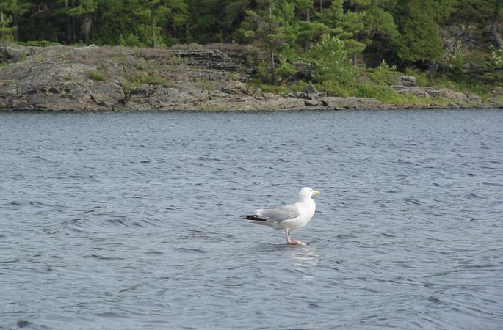
Notes:
You are traveling in a boat and spot this bird, a solitary seagull and take it’s picture.
What do you see in this picture?
A cute picture of a sea gull?
Hey ask the captain if he can get closer so I can get a better picture!
Like the sea gull we will talk about watching...

Slide 6
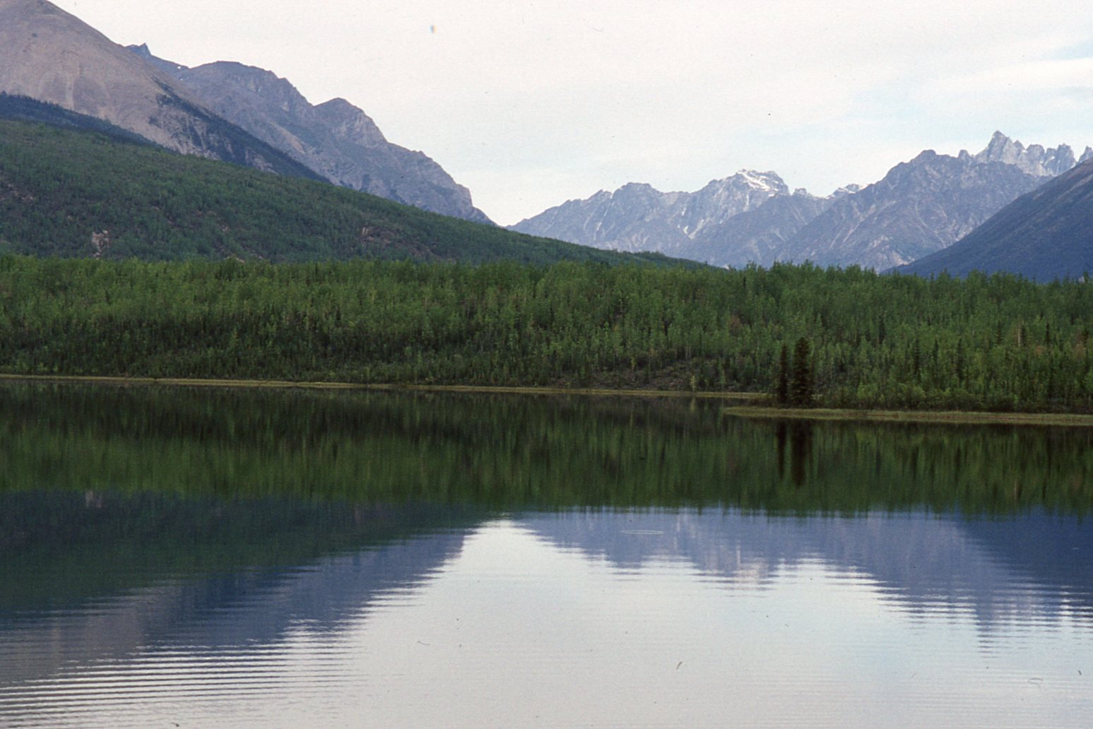
Notes:
We live in a busy world, confusion, distractions, places to hurry to, with no apparent direction.
The life we have here is full of contradictions.
What does this look like when we strip away man. Everyone going in a different direction. It is near impossible to see the right way!
Buy and sell,
consume and acquire, go here, go there.
{Click}
When as much of man’s creation is taken away then we can see the Truth.
The heavens declare the glory of God; And the firmament shows His handiwork.
We are going to go on a long journey to get to this river.

Slide 7
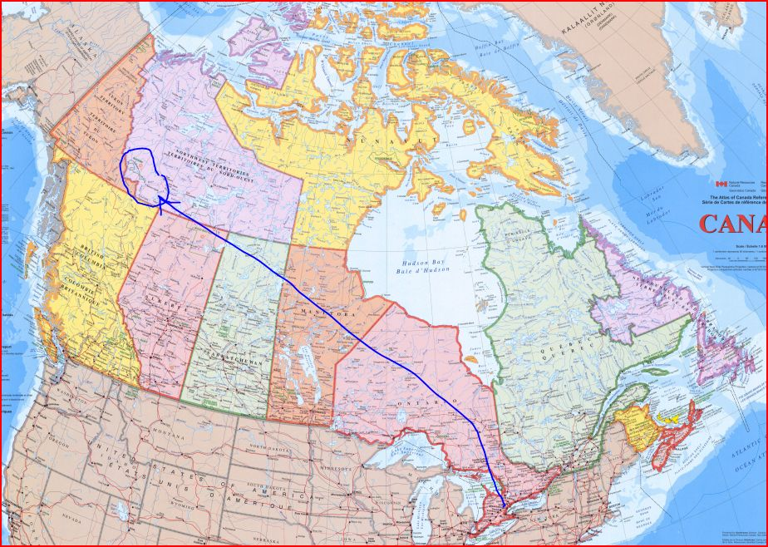
Notes:
We are at 35Degrees lat, and will be about 62 degrees Lat. A journey of 10,000 miles from here.
About as far as most of use have ever traveled.

Slide 8
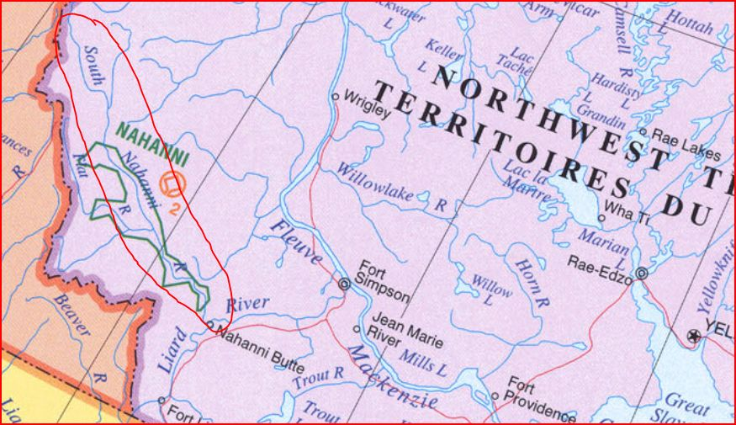
Notes:
We will venture into an area that none are familiar with. We will rely on the guidance of those that have the experience, those that have traveled these waters before us.
In effect the shepherds and watchmen must lead and protect us for the next three weeks.
The river is 600Km long

Slide 9
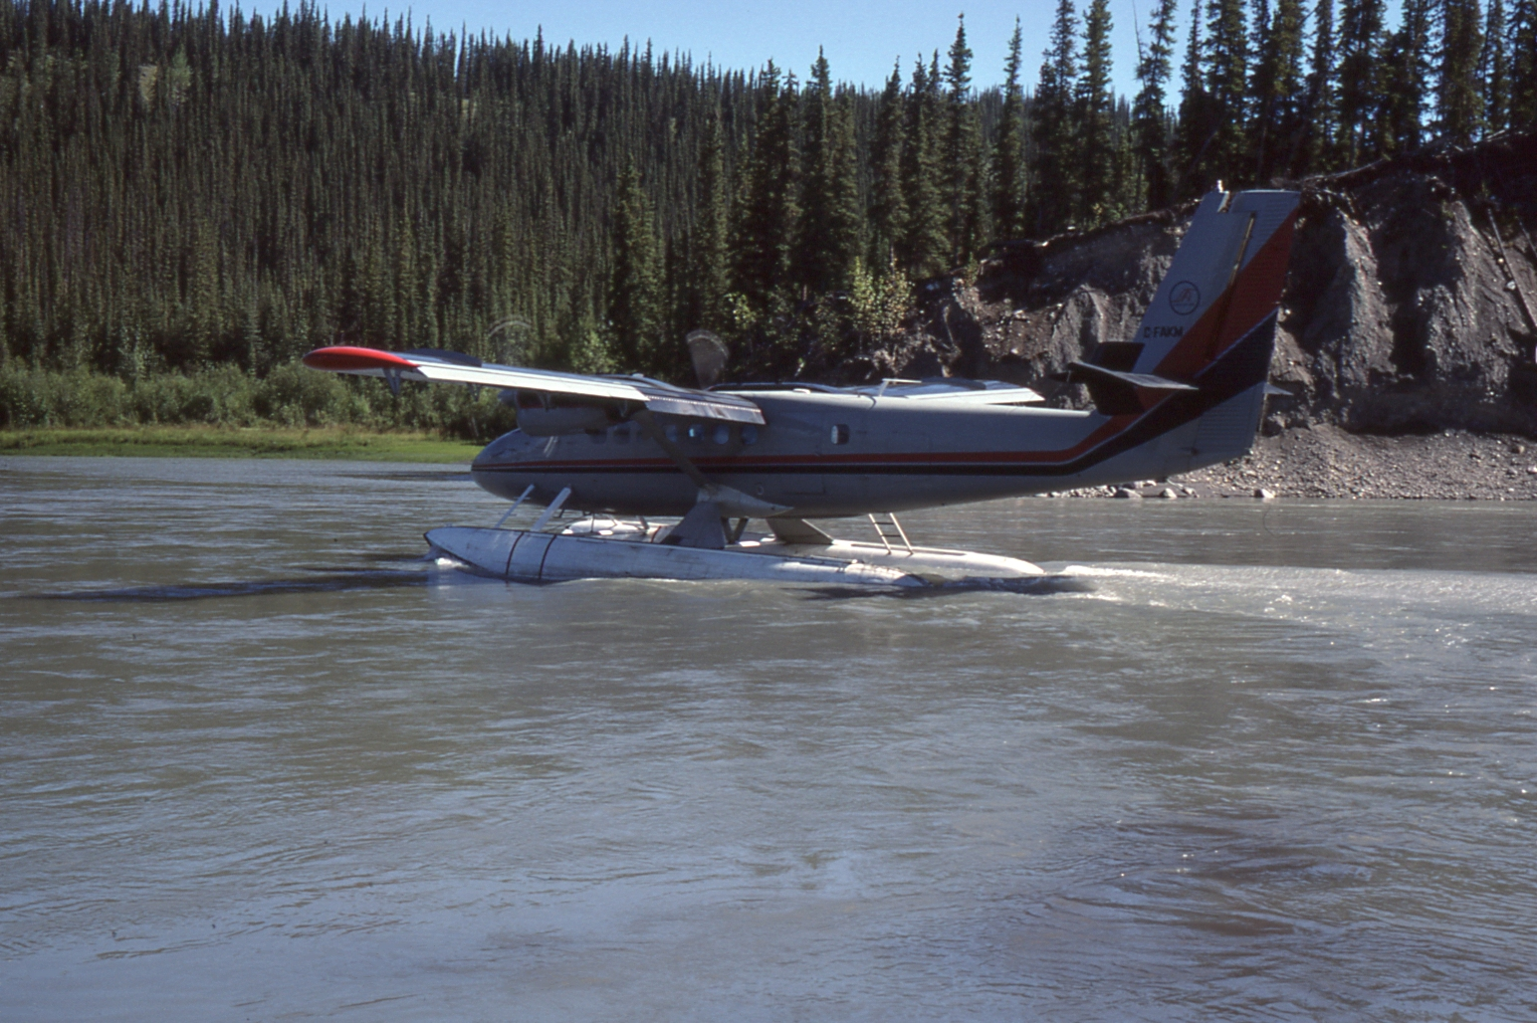
Notes:
Once the plane leaves there is no turning back, the only way home is down river!
Whatever we have with is. That is all we can depend on.

Slide 10
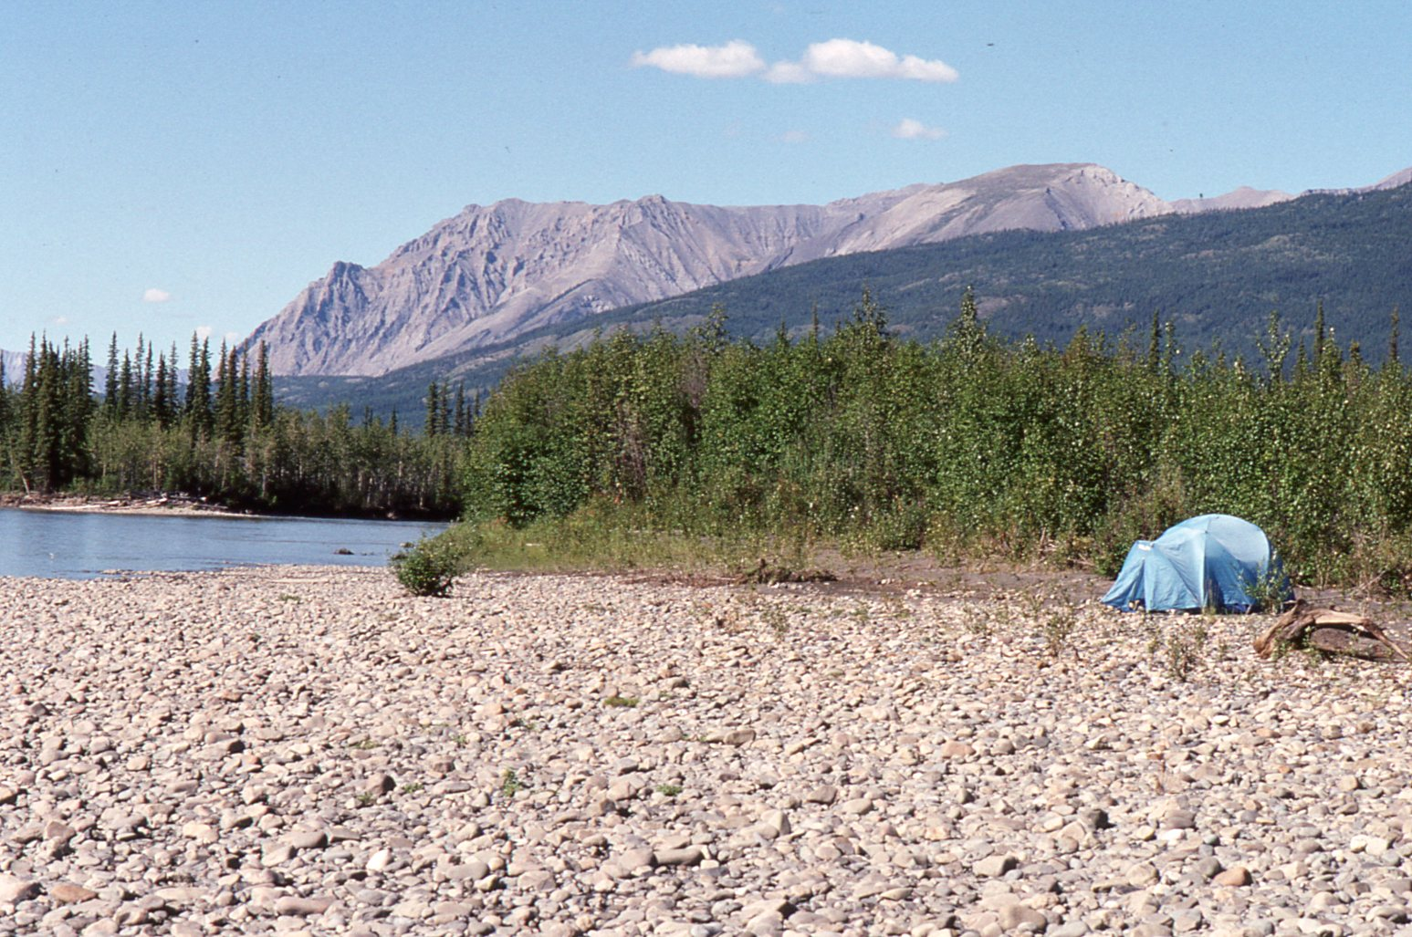
Notes:
No distractions, the influences of the city is gone, A canoe, a pack and a place to sleep, what more can one need!
As far as the eyes can see only the presence of Yahweh!
Truly separated from the world!
We have been talking about the need to separate and prepare the past two nights.

Slide 11
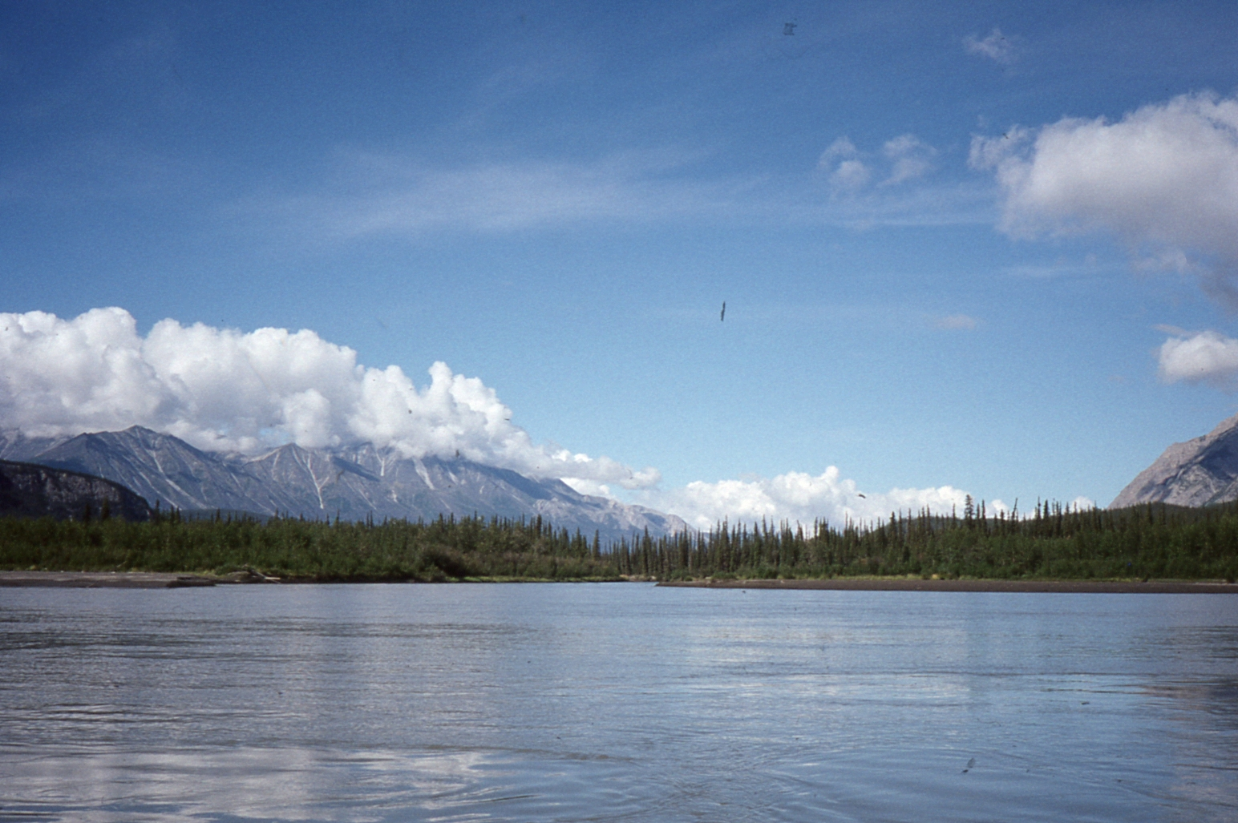
Notes:
Mountain ranges bracket the river. Progress is measured by the passing of mountains

Slide 12
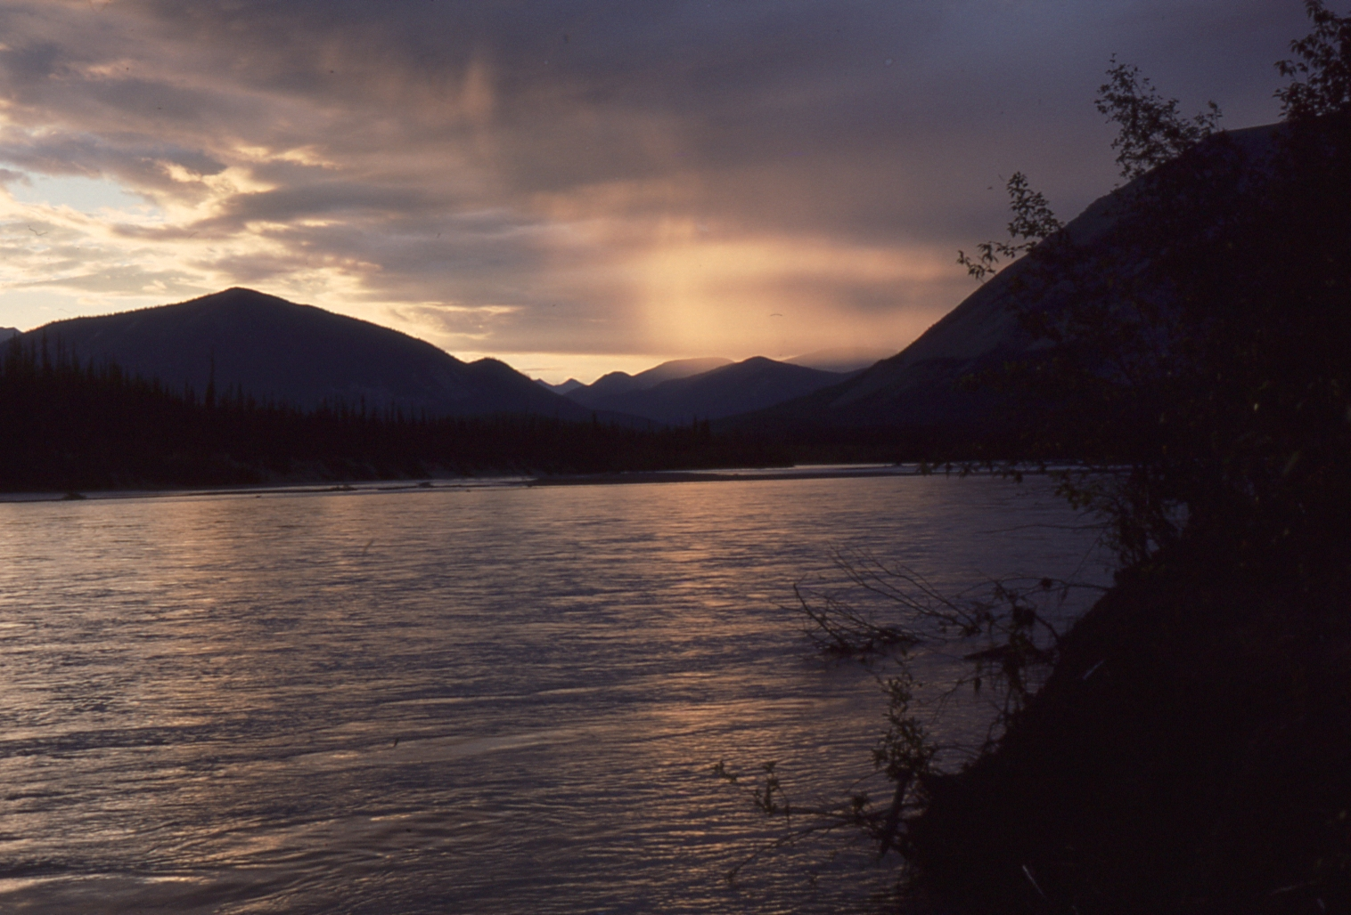
Notes:
Land of the midnight sun!
Yahweh’s light is always present!

Slide 13
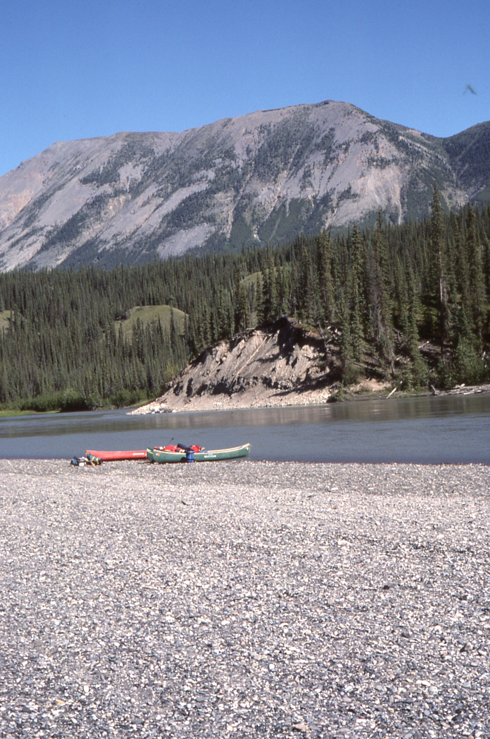
The world is has been wonderfully created with much beauty, peaceful, quiet and safe
Notes:
We are protected by high mountains, the river is smooth. We are save!
What peace can be felt when every stone has been place by Yahweh, man has not move them!

Slide 14
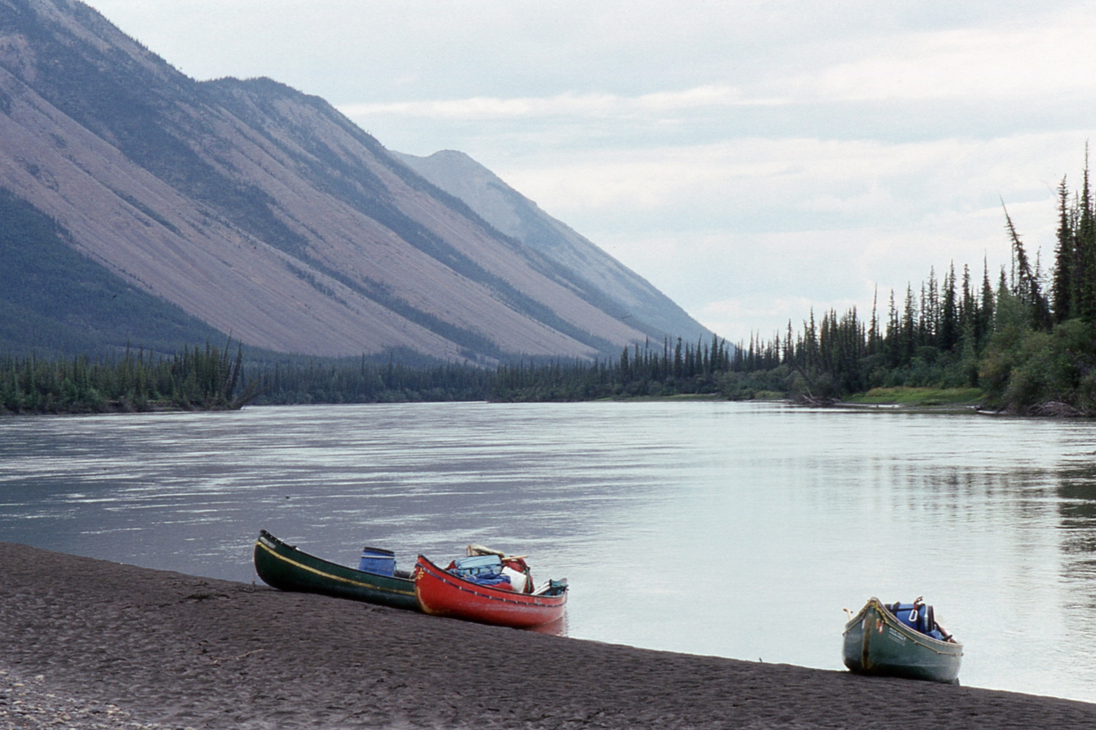
Notes:
We are alone in the world, just 10 people working together. Everyone has the same objective and common goals.
Riding in small boats, insignificant against the backdrop of what Yahweh has shown us.
2000 foot mountains rise from the river edge. How magnificent is it to ponder that Yahweh does know us.

Slide 15
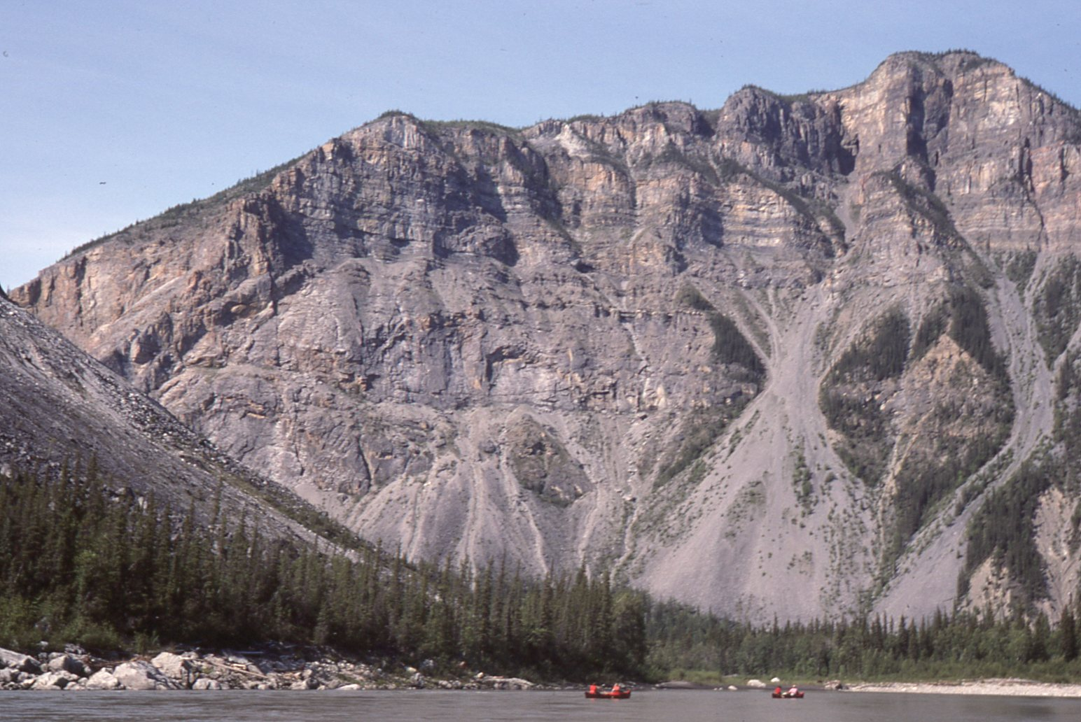
Notes:
Faith that we are really not as insignificant as we feel, the cirque of the unclimbables tower above us.

Slide 16
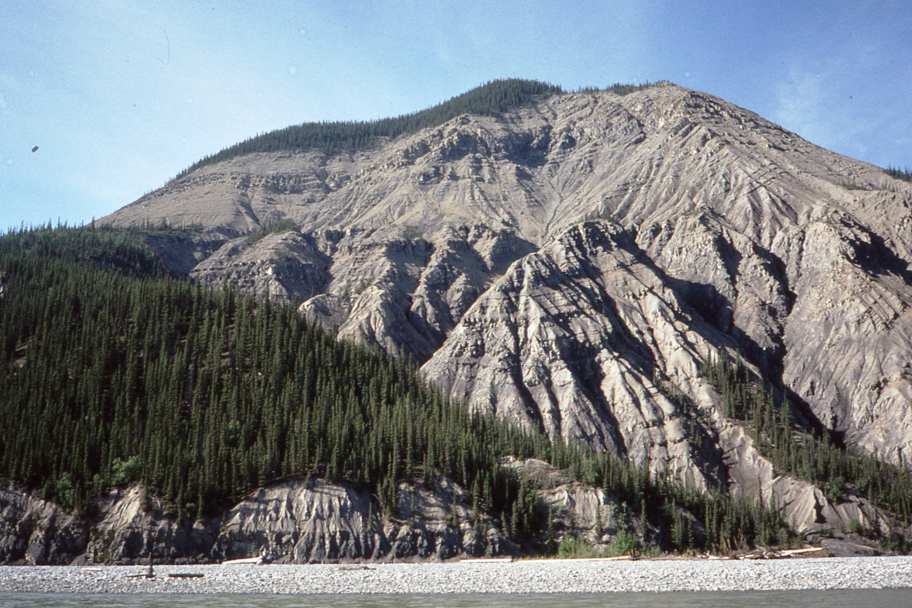
Notes:
His hand has carved the mountains and provided the path for the river to run!
The path that we must take is obvious!
This looks like a peaceful drift and the next three weeks will be relaxing!

Slide 17
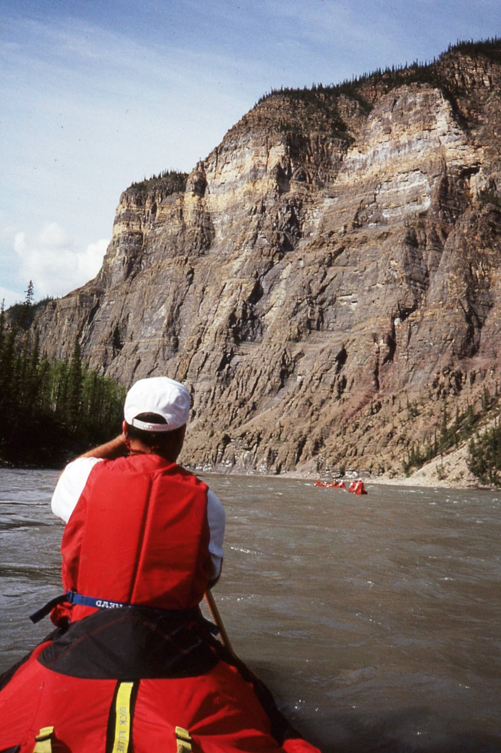
The river current seems to be picking up a bit.
Notes:
Quietly and very subtly the river picks up speed.
Each day it gets a bit faster.
We do not notice it at first.
But after a few days the change is apparent.
Something is different!

Slide 18
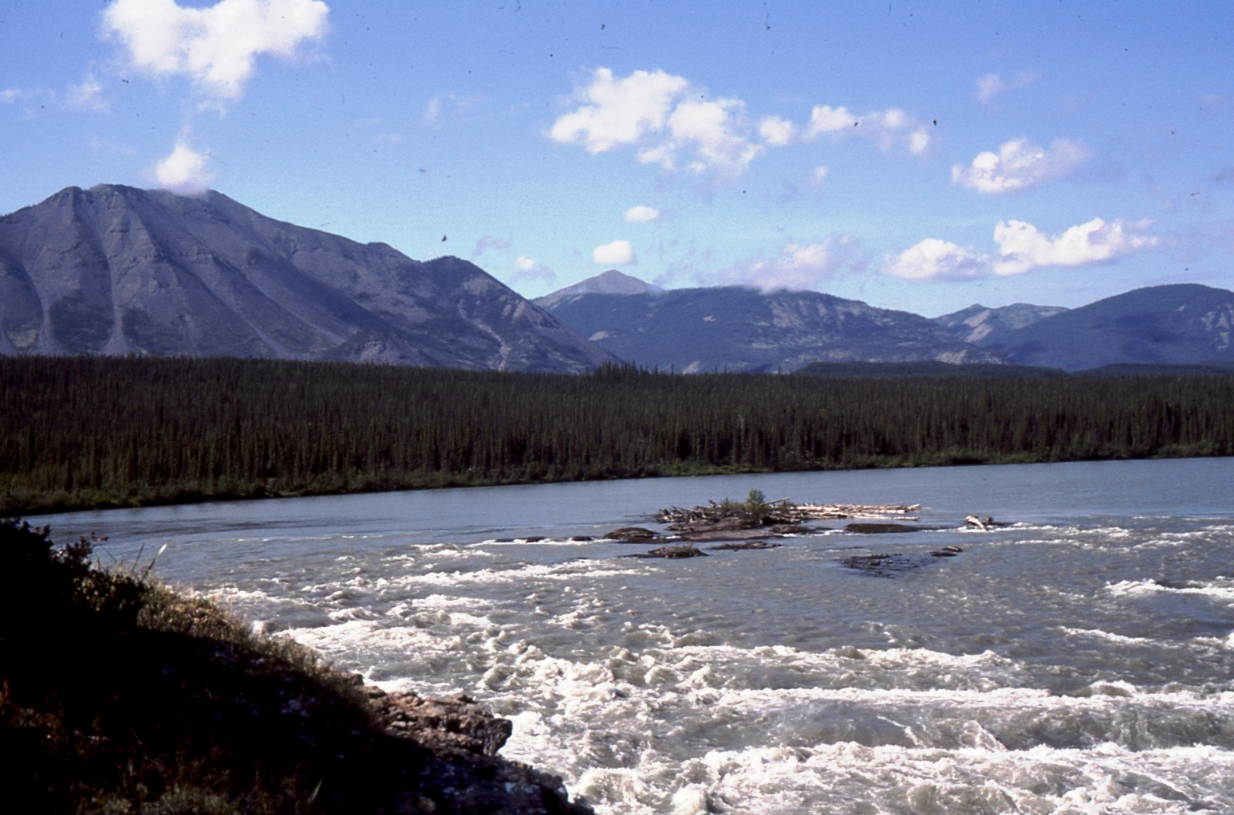
Notes:
It goes from calm and peaceful to some class 1 rapids. Well we have no trouble with those, we have handled up to class 3 rapids many times over the years. These should be no problem, even a bit of fun.
A challenge a change of pace after so may days of smooth water.
We should take a vote to run these too!
But it would be a fatal mistake!
If not for the knowledge of those that have gone before us we may have been caught in the trap of Virginia Falls.

Slide 19
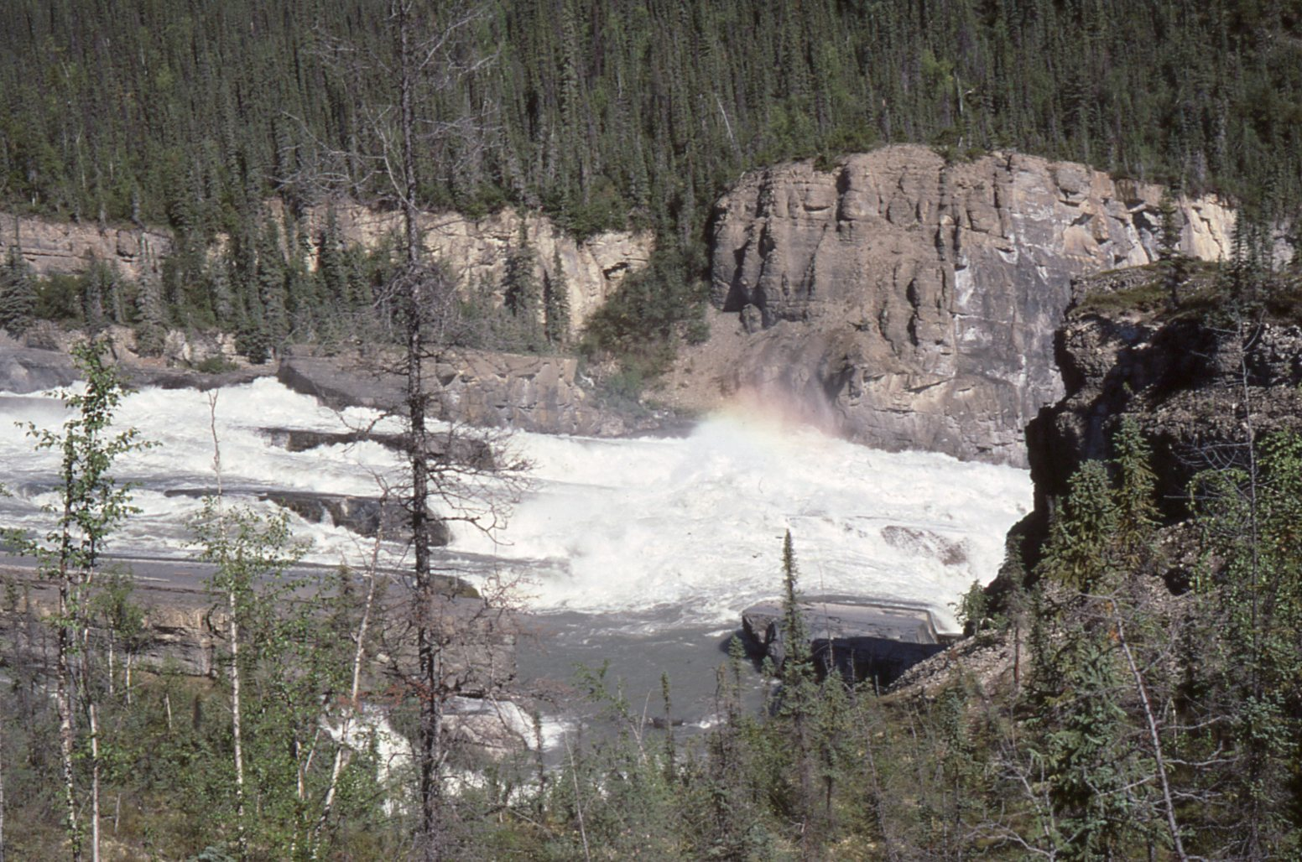
Notes:
OPPS...
But a few hundred yards further on the story changes. We are caught with no escape! The river has us trapped and the current has us. There is nothing to do no but ride it out. Class 1 soon become class 4.
Our Guides, the watchmen of our tiny group knew of the danger and shepherd us over to the shore in plenty of time.

Slide 20
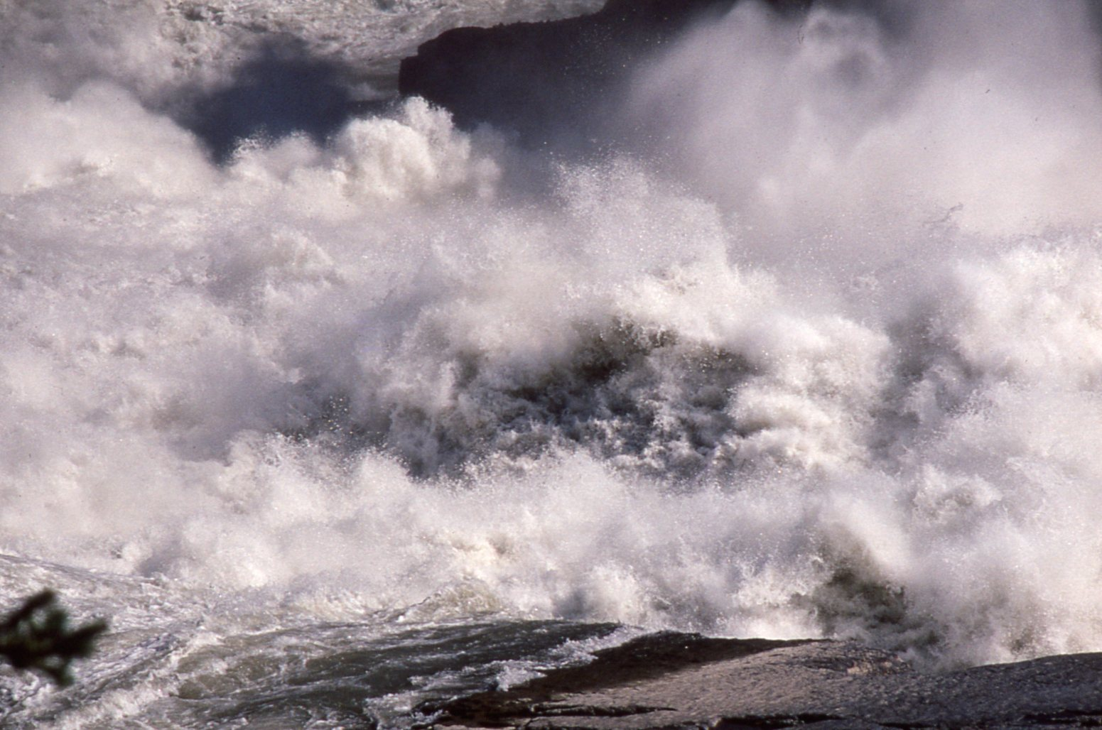
Not User Friendly
Notes:
What we would call
“not user friendly!”
Class 4 become class 5+ - Certain death!

Slide 21
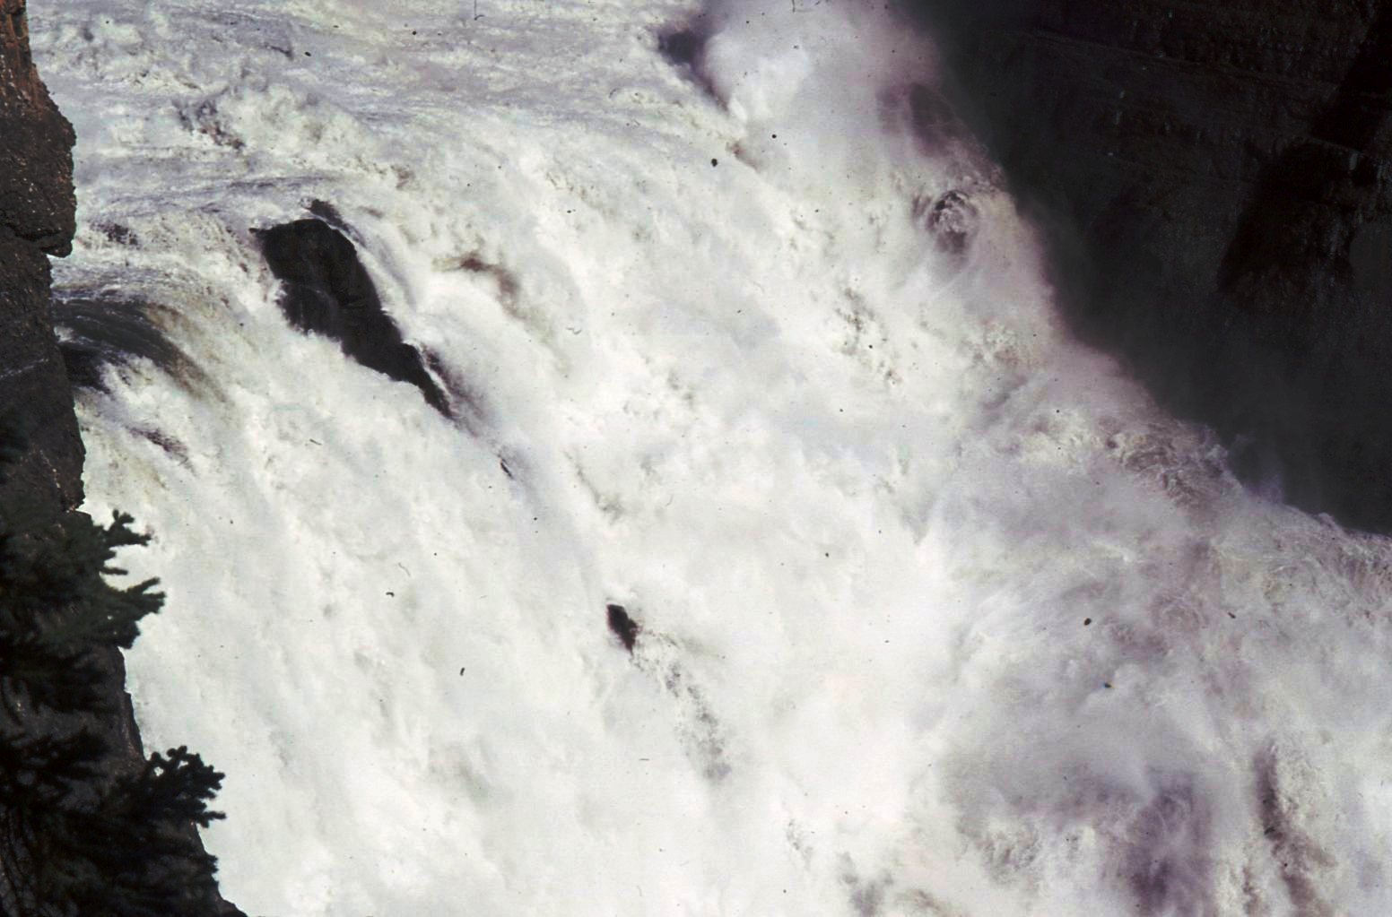
Notes:
Death is a certainty

Slide 22
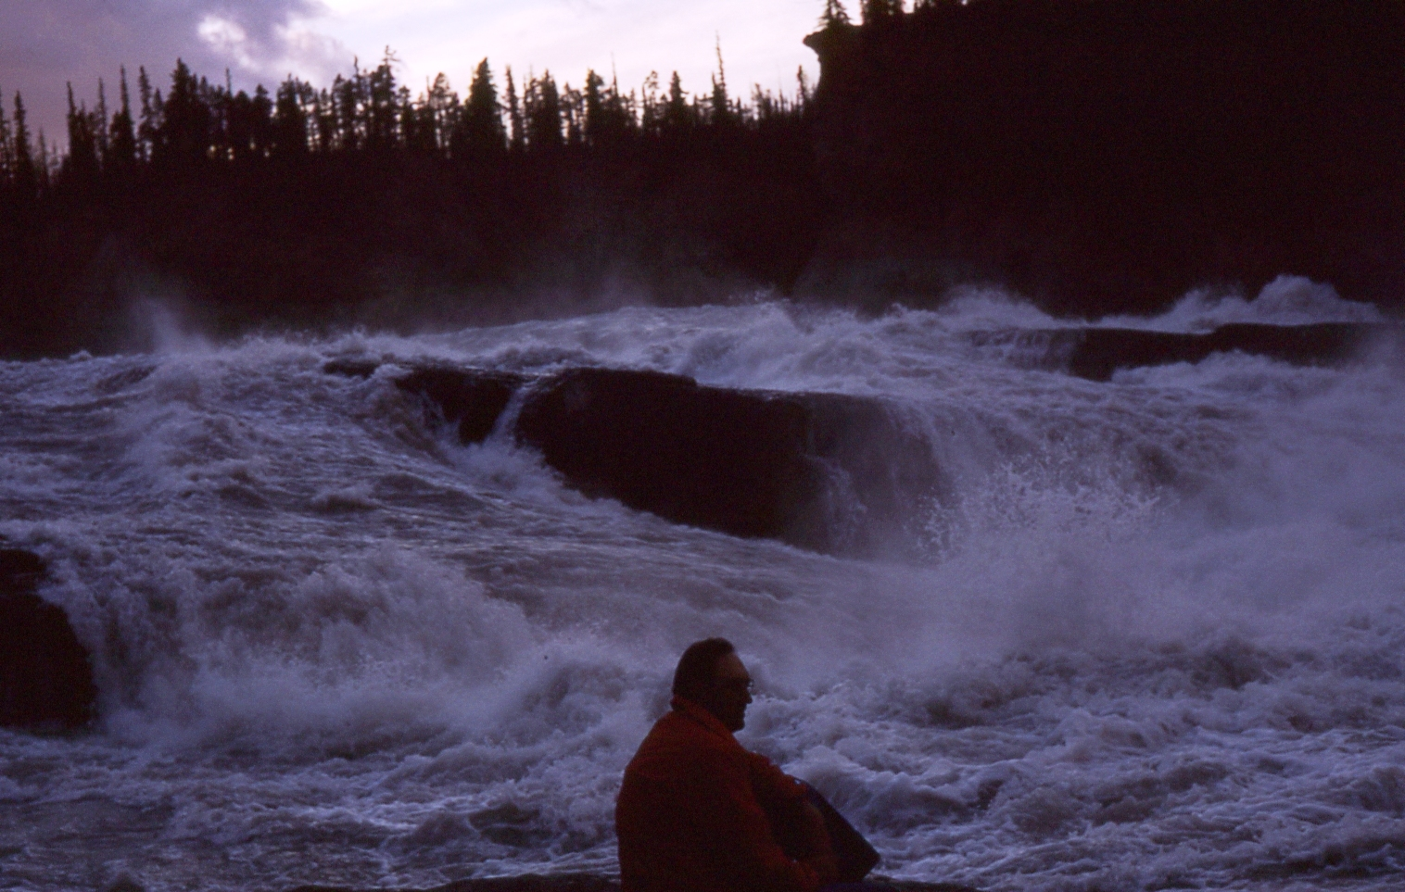
Notes:
Wonderful to watch and ponder the power that the almighty created and be thankful we are not caught up in the current.
The world is much the same.
If not for the watchmen and shepherds I would not have had the opportunity to sit here. To listen and feel the power of the water.

Slide 23
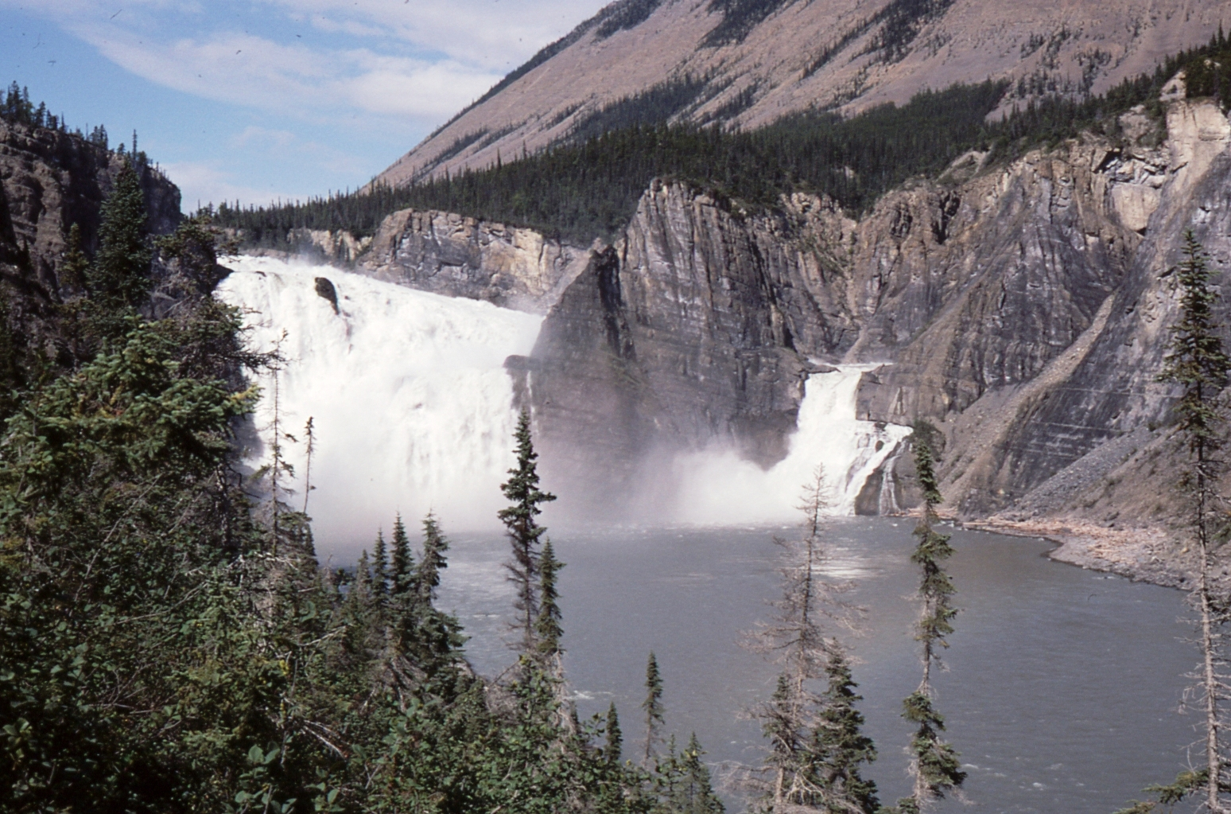
Notes:
We can marvel at the creation. Virginia Falls, Seen by only a few hundred people each year.
2X the height of Niagara.

Slide 24
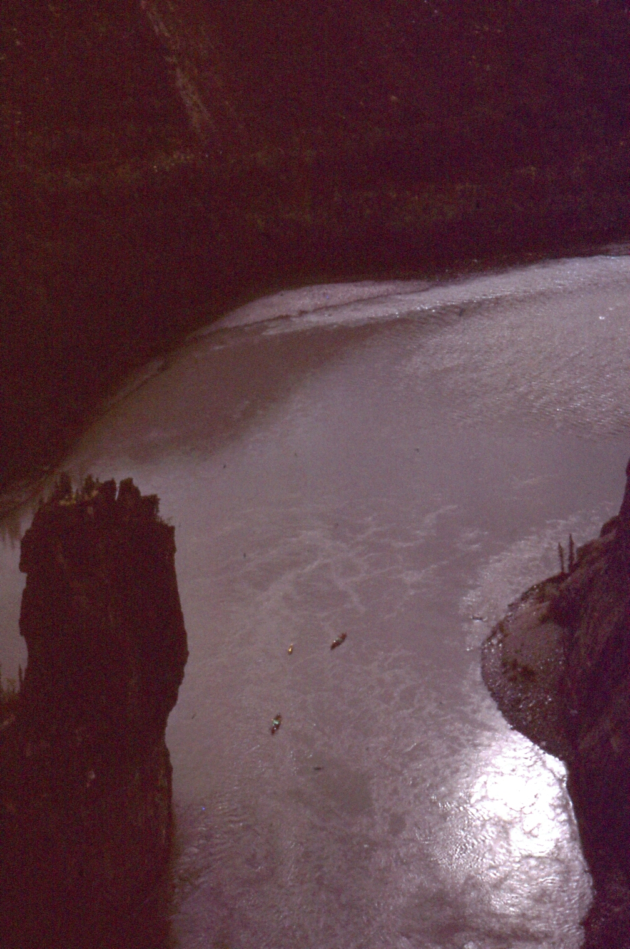
It is He who sits above the circle of the earth, And its inhabitants are like grasshoppers, Who stretches out the heavens like a curtain, And spreads them out like a tent to dwell in. He brings the princes to nothing; He makes the judges of the earth useless.
Isaiah 40:22-23
Notes:
3 small boats 2000 ft below,

Slide 25
Fear and Tremble
When I consider Your heavens, the work of Your fingers, The moon and the stars, which You have ordained, What is man that You are mindful of him, And the son of man that You visit him?
Psalms 8:3-4
Notes:
We have stripped away the city and shown the creation as it was in the beginning.
Where the waters flowed over the face of the earth and man was able to see the work of Yahweh.

Slide 26
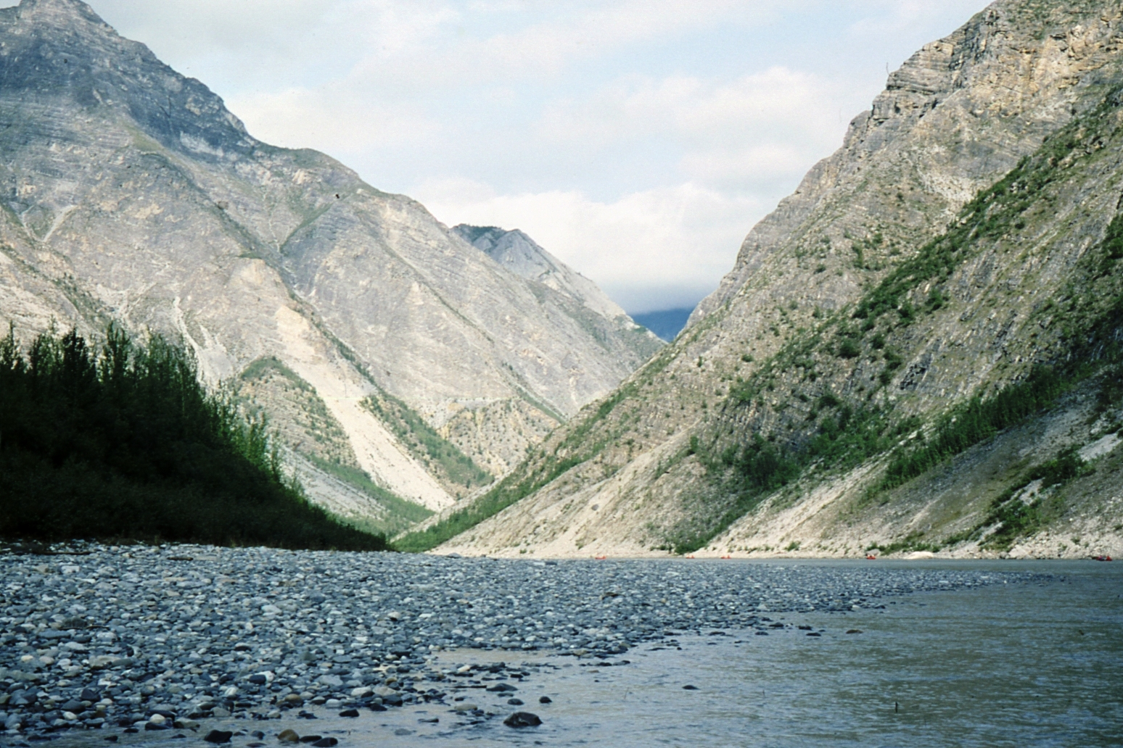
Notes:
Here we see 5 small boats, 10 people against the backdrop of creation. Only the boats and what they contain is man’s work the rest is all Yahweh!
But we must return to the city.
We only have a memory of what is really behind there behind all the layers that man has added.
{click}
How different this is from the river, it is a lot more difficult to see the hand of Yahweh
Are we any less alone?
Do we need any less the leadership of shepherds and watchmen?
Do you feel safer here that on the river?
If so why is that?
Are we too familiar with the world and feel comfortable!

Slide 27
Let’s look closely at:
Lies
Watchmen
Shepherds
Our Preparation
Notes:
We will consider tonight, the lies used by the serpent and those around us to change us and draw us away from the truth
The duties of watchman,
The duties of the shepherds
and finally how all applies to our preparation as espoused brides of the Bridegroom.
This week we have had much spiritual food and it will take time to reflect on all we have heard.

Slide 28
The Serpent Lies
Now the serpent was more cunning than any beast of the field which the LORD God had made. And he said to the woman, "Has God indeed said, 'You shall not eat of every tree of the garden'?" And the woman said to the serpent, "We may eat the fruit of the trees of the garden; but of the fruit of the tree which is in the midst of the garden, God has said, 'You shall not eat it, nor shall you touch it, lest you die.’
Notes:
Next

Slide 29
The Serpent Lies
Then the serpent said to the woman, "You will not surely die. For God knows that in the day you eat of it your eyes will be opened, and you will be like God, knowing good and evil." So when the woman saw that the tree was good for food, that it was pleasant to the eyes, and a tree desirable to make one wise, she took of its fruit and ate. She also gave to her husband with her, and he ate.
Genesis 3:1-6
Notes:
On the river we have more clarity, we are not surrounded by the contradictions of the human race. We can more easily see the truth from the lies.

Slide 30
Three lies
1) Good for food
2) You will not die
3) Make one wise
Notes:
The serpent’s words and the dialogue with Eve contained three lies

Slide 31
Three lies
1) There is no difference
2) There is no penalty
3) There are benefits
Notes:
The serpent convinced Eve that:
The forbidden tree was really no different from all the others
The penalty that was promised would not happen
You will possess great knowledge after eating the fruit
This line of reasoning is real hard to defend against.

Slide 32
Drug Dealers use these too!
1) There is no difference
2) There is no penalty
3) There are benefits
Notes:
The dealers will say to you. Come on these pills are the same as the one’s your parents take! There is no difference!
Who will catch you? No one will know,
and even if you are caught nothing will happen.
And after you take one you will feel so much better!
When you young ones here this line of reasoning be very suspicious of the intent, NO matter who says them!
Train yourselves to watch our for these three statements.
They may be concealed a path that leads to death, away from the truth, cause you to violate your marriage vows!
The argument is strong and you will be made to feel uncomfortable if you reject them
You will feel that it is your fault, you will feel guilty if you don’t partake of their evil.

Slide 33
Do we hear these?
1) There is no difference
2) There is no penalty
3) There are benefits
Notes:
Do we hear brothers or sisters telling us that other doctrines are the same as ours, that there is no difference!
So we should join them, there is no down side, We are all baptised, we are one!
And you know how much better we will all be when we join them, greater numbers, more and better teachers, peace and joy all the time!

Slide 34
We do hear these lies!
Responsible gathered with the Christ
Divorce and remarriage
Free Life
Immortal Emergence
Kingdom here today
No sin in the Flesh
Notes:
These errors are told to us in person, in literature, we are pressured with the same three lies in each of these and more examples.
We each know of many that have been convinced by this pattern of lies and accepted these errors
We are encouraged to invite them to speak to us to teach us their ways!
We are told to no have controversy but accept with love their new doctrine!

Slide 35
There is no Difference!
That which was from the beginning, which we have heard, which we have seen with our eyes, which we have looked upon, and our hands have handled, concerning the Word of life--the life was manifested, and we have seen, and bear witness, and declare to you that eternal life which was with the Father and was manifested to us--that which we have seen and heard we declare to you, that you also may have fellowship with us; and truly our fellowship is with the Father and with His Son Jesus Christ. And these things we write to you that your joy may be full.
1 John 1:1-4
Notes:
There is only one truth!
Seen
Heard
Handled
Truth Declared to us in the words given

Slide 36
There is no Difference!
This is the message which we have heard from Him and declare to you, that God is light and in Him is no darkness at all. If we say that we have fellowship with Him, and walk in darkness, we lie and do not practice the truth. But if we walk in the light as He is in the light, we have fellowship with one another, and the blood of Jesus Christ His Son cleanses us from all sin.
1 John 1:5-7
Notes:
This truth leads to fellowship
Fellowship with bridegroom and one another based on this truth!

Slide 37
Word of Truth
For this reason we also thank God without ceasing, because when you received the word of God which you heard from us, you welcomed it not as the word of men, but as it is in truth, the word of God, which also effectively works in you who believe.
1 Thessalonians 2:13
Notes:
The word of truth when accepted is a cause for great celebration.
The truth is the words of Yahweh!
We are to hold to it!

Slide 38
There is no penalty!
There is a way that seems right to a man, But its end is the way of death.
Proverbs 14:12
What fruit did you have then in the things of which you are now ashamed? For the end of those things is death.
Romans 6:21
Notes:
There is a penalty!
It is the same as in the garden
DEATH

Slide 39
You will be better off!
Whoever transgresses and does not abide in the doctrine of Christ does not have God. He who abides in the doctrine of Christ has both the Father and the Son.
2 John 1:9
Notes:
So shall we say
“Let us believe what will be the most agreeable to everyone”
It is essential that Yahweh’s TRUTH be the basis of our fellowship!
Doctrine of Christ is the foundation of Fellowship!

Slide 40
There are many interpretations
There are many religions
There are many versions of what people want the bible to say
BUT THERE IS ONLY ONE TRUTH!

Slide 41
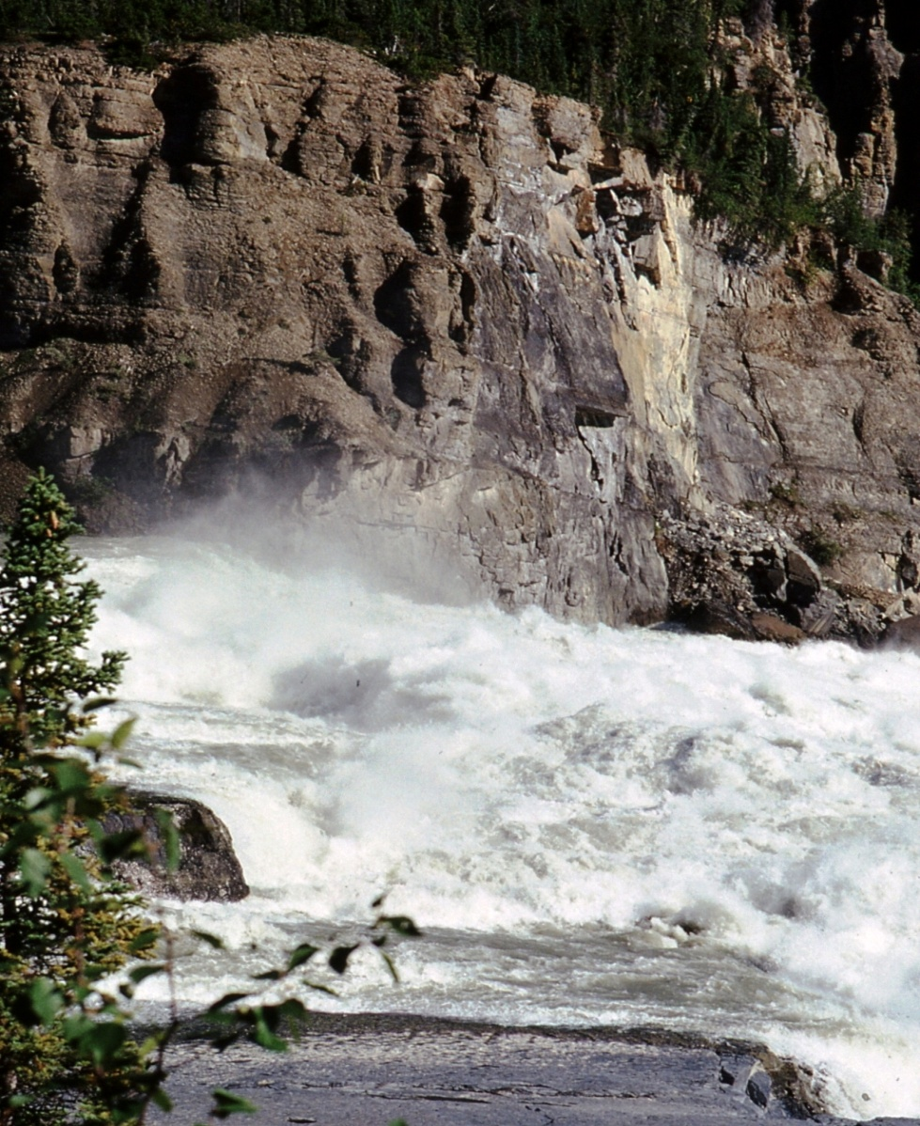
Watchmen and Shepherds
Let us take a vote on that!
Notes:
It is the duty of those with experience to lead us through difficult times, and warn us of dangers to come. The word of Yahweh being their guide.

Slide 42
Watchmen and Shepherds
Ezekiel 33 - Watchmen
Ezekiel 34 - Shepherds
Notes:
Ezekiel 33 and 34 deal with Yahweh’s admonition to the watchmen and shepherds of Israel. We looked at these chapters in more detail in Bro Mac’s Class

Slide 43
Watchmen
Notes:
Watchmen have a role in warning about impending danger
Watchmen must be knowledgeable
Watchmen must be vigilant
Watchmen must be persistent
Watchmen must know the truth
Watchmen must defend the truth
{Click} Shofar
They must sound the warning!

Slide 44
Notes:
If you were the watchman on this boat the sight of this sea gull would cause you to shout an alarm. You would know that birds do not walk on water and that danger is coming from below!

Slide 45
Not Silent
I have set watchmen on your walls, O Jerusalem; They shall never hold their peace day or night. You who make mention of the LORD, do not keep silent, and give Him no rest till He establishes and till He makes Jerusalem a praise in the earth.
Isaiah 62:6-7
Notes:
Watchmen are to always cry out a warning against all dangers
They are never told to remain silent!
They are never instructed to wait and see what happens!
They are never asked to let the people decide!

Slide 46
Listen to the Warning
Also, I set watchmen over you, saying, 'Listen to the sound of the shofar!'
But they said, 'We will not listen.'
Jeremiah 6:17
Notes:
Regardless of those that ignore the warning the cry still must go out.
But many will still ignore the watchmen,
Ignore the sound of the shofar
But that does not mean the watchmen should not still sound a warning!
We can’t force anyone to heed the sound and respond to the warning

Slide 47
Warning to Watchmen
Son of man, I have made you a watchman for the house of Israel; therefore hear a word from My mouth, and give them warning from Me: When I say to the wicked, 'You shall surely die,' and you give him no warning, nor speak to warn the wicked from his wicked way, to save his life, that same wicked man shall die in his iniquity; but his blood I will require at your hand.
Ezekiel 3:17-18
Notes:
Duty of the watchmen is to save them by warning and himself by giving the warning.
The duty of a watchman is a great responsibility.
He must speak the word of Yahweh.
He must hold to the truth of Yahweh.

Slide 48
Watchmen Failed
His watchmen are blind, They are all ignorant; They are all dumb dogs, They cannot bark; Sleeping, lying down, loving to slumber.
Isaiah 56:10
Notes:
It is a never ending job!
A watchman cannot sleep
He cannot fail to sound a warning
He cannot forget the truth in complacency
He must not be ignorant of ways of Yahweh
The people may ignore the watchman
The people may not listen

Slide 49
Saved by the Watchman
By night on my bed I sought the one I love; I sought him, but I did not find him. "I will rise now," I said, "And go about the city; In the streets and in the squares I will seek the one I love." I sought him, but I did not find him. The watchmen who go about the city found me; I said, "Have you seen the one I love?“
Song of Solomon 3:1-3
Notes:
Looking for love in all the wrong places!
Here the watchman finds the bride looking for her groom in all the wrong places.
Are we watchmen.
The watchman is able to prevent the bride from falling into an adulterous situation.
The watchman is able to lead the bride back to the one groom, that person with whom she is espoused
The person she is in covenant with.
Can the watchman fail to do his duty? Would the loss of the bride fall on his shoulders?

Slide 50
Marriage vows
Exclusive to our marriage vows
Warn when we see activities that would lead to adultery
Notes:
We are to be busy preparing ourselves. The watchmen have double duty to prepare themselves and to alert us to coming dangers.
They must lead us away and back to the bridegroom.
How strong a warning do you want?
How forceful do you want them to be?
Think back to Virginia falls and how the water started to pick up speed.
Would it have been good enough for the guides to simply say “I wouldn’t go there if I were you” or should they drag us kicking and screaming to shore?
When sure death is involved what is your expectation?
Well that is what we are dealing with here.
How do we treat those that watch over us?
Don’t Fear them, give them a hug for they deserve a double reward.

Slide 51
Watchmen’s Failure
When I say to the wicked, 'O wicked man, you shall surely die!' and you do not speak to warn the wicked from his way, that wicked man shall die in his iniquity; but his blood I will require at your hand.
Ezekiel 33:8
Notes:
When Yahweh speaks and the watchmen fail to warn the people will die.
But the death is also on the heads of the watchmen for failure to carry out their duty!
BUT... {next}

Slide 52
Watchmen’s Success
Nevertheless if you warn the wicked to turn from his way, and he does not turn from his way, he shall die in his iniquity; but you have delivered your soul.
Ezekiel 33:9
Notes:
BUT if the watchman is faithful to Yahweh and warns the people of their sins regardless of if the people listen the watchman will be saved!

Slide 53
Watchmen Today
Brethren, if anyone among you wanders from the truth, and someone turns him back, let him know that he who turns a sinner from the error of his way will save a soul from death and cover a multitude of sins.
James 5:19-20
Notes:
Is this not what the watchmen are to do

Slide 54
Shepherds Duty
Strengthen the weak
Heal those that are sick
Bind up the broken
Bring back what was driven away
Sought what was lost
Feed them the Word of Truth
Notes:
What about the role of the shepherds?
Chapter 34 of Ezekiel deals with shepherds

Slide 55
Shepherds
Son of man, prophesy against the shepherds of Israel, prophesy and say to them, 'Thus says the Lord GOD to the shepherds: "Woe to the shepherds of Israel who feed themselves! Should not the shepherds feed the flocks?
Ezekiel 34:2
Notes:
Duty of shepherd to feed the people with the word of Yahweh
Feed those that they have with good food.
Feed with the word of truth!

Slide 56
Failure of the Shepherds
So they were scattered because there was no shepherd; and they became food for all the beasts of the field when they were scattered. My sheep wandered through all the mountains, and on every high hill; yes, My flock was scattered over the whole face of the earth, and no one was seeking or searching for them. Ezekiel 34:5-6
Notes:
Shepherds are lost too!
Many have been lost due to the incompetent shepherd!

Slide 57
Warning to Shepherds
"Woe to the shepherds who destroy and scatter the sheep of My pasture!" says Yahweh. Jeremiah 23:1
Notes:
Shepherds – gather or scatter?
Yahweh’s wrath on those that fail in this role!

Slide 58
Yahweh will Gather
For thus says Yahweh:
Indeed I Myself will search for My sheep and seek them out.
Ezekiel 34:11
Notes:
In the end Yahweh will complete the task where the shepherds have failed and gather those that are his faithful

Slide 59
Yahweh Gathers
Give ear, O Shepherd of Israel, You who lead Joseph like a flock; You who dwell between the cherubim, shine forth!
Psalms 80:1
Notes:
Yahweh as the shepherd of his people.
Where his truth is spoken to guide his people.
The benchmark of our duty:
The word of Yahweh
The one singular truth that has been spoken from the beginning of creation.

Slide 60
Follow the Truth
Remember those who rule over you, who have spoken the word of God to you, whose faith follow, considering the outcome of their conduct.
Hebrews 13:7
Notes:
The watchmen and the shepherd
Warning and speaking the ONE TRUTH
For in both cases if the watchmen and shepherds fail to do their job and only lookout for themselves they will DIE

Slide 61
Marriage
Covenant Relationship
Notes:
We take the example and Warning from the nation of Israel.

Slide 62
Covenant Marriage
...not according to the covenant that I made with their fathers in the day that I took them by the hand to lead them out of the land of Egypt, My covenant which they broke, though I was a husband to them, says the LORD.
Jeremiah 31:32
Notes:
Restoration to a relationship to Yahweh based on a covenant.
Restore to a relationship with Yahweh that is like a marriage.

Slide 63
Faithful ?
You are an adulterous wife, who takes strangers instead of her husband.
Ezekiel 16:32
Notes:
They searched out false gods and embraced false doctrine
They grew Proud
They forgot their beginning
They were weak in understanding
When one looks to another god, another truth,
And one departs from the one they are covenanted to the language of Yahweh is strong.

Slide 64
From Adultery to Faithful
For their mother has played the harlot; She who conceived them has behaved shamefully. For she said, 'I will go after my lovers, Who give me my bread and my water, My wool and my linen, My oil and my drink.'
Hosea 2:5
Notes:
Other ways seem better
Happier
Prosperous

Slide 65
Pride
But you trusted in your own beauty, played the harlot because of your fame, and poured out your harlotry on everyone passing by who would have it.
Ezekiel 16:15
Notes:
How did they fall into this state?
They turned from Yahweh to worship false gods.
They became proud of their beauty and desired others over the one that is their husband.

Slide 66
Forgot their Beginning
And in all your abominations and acts of harlotry you did not remember the days of your youth, when you were naked and bare, struggling in your blood.
Ezekiel 16:22
Notes:
They did not remember their first love, they sought joy and happiness elsewhere.
They forgot the one they loved!

Slide 67
Weak in Understanding
How weak is your heart! says the Lord GOD, seeing you do all these things, the deeds of a brazen harlot.
Ezekiel 16:30
Notes:
They forgot the one truth.
Modifying it until it had no resemblance to the word of Yahweh.
Changing the truth to justify their actions.
Justifying their acts of adultery.

Slide 68
Unfaithful Bride
Pride
Forgot their Beginning
Weak in Understanding

Slide 69
Warning
And I said, after she had done all these things, 'Return to Me.' But she did not return. Then I saw that for all the causes for which backsliding Israel had committed adultery, I had put her away and given her a certificate of divorce.
Jeremiah 3:7-8
Notes:
The people were lost and turned to another, forsaken Yahweh.
Yahweh was willing to take them back, to forgive them.
But they rejected him and his covenant with them
He divorced them!

Slide 70
Restoration
She will chase her lovers, But not overtake them; Yes, she will seek them, but not find them. Then she will say, I will go and return to my first husband, For then it was better for me than now.
Hosea 2:7
Notes:
Restoration required a change in thought, action and desires.
Just as the nation desired to return to their husband those we seek to restore must also have this same passion.
How can we convince someone to return to their husband?
How can we convince someone that it will be better than it is now?
The realization to heed the watchman and to follow the shepherd

Slide 71
Restore to Yahweh
"I will betroth you to Me forever; Yes, I will betroth you to Me In righteousness and justice, In loving kindness and mercy; I will betroth you to Me in faithfulness, And you shall know Yahweh.
Hosea 2:19-20
Notes:
Yahweh does not say here, “I will forgive her;” “I will restore her;” “I will receive her back again;” “I will again show her love and tenderness.” Much as these would have been, He says here much more.
He so blots out, forgets, abolishes all memory of the past, that He speaks only of the future, of the new betrothal, as if it were the first espousal of a virgin. Hereafter God would make her wholly His, and become wholly hers, by a union nearer and closer than the closest bond of parent and child, that, whereby they are “no more twain, but one flesh;”
THE GRACE OF YAHWEH

Slide 72
Then you will Know Yahweh
Righteousness
Justice
Loving Kindness
Mercy
Faithfulness
Notes:
All these characteristics that one desires in a spouse, those that many have searched the world for in a lover while ignoring Yahweh’s word can be lead back by an observant watchman and a good shepherd that both know the will of Yahweh, are faithful to his covenant, and the one truth.

Slide 73
Remain Faithful
But the Lord is faithful, who will establish you and guard you from the evil one. And we have confidence in the Lord concerning you, both that you do and will do the things we command you.
2 Thessalonians 3:3-4
Notes:
Yahweh is faithful to those that are his.
We must be faithful to him.
This a call to remain faithful to him
Paul's words of encouragement to us this day that we will do the things commanded of us.

Slide 74
Faithful
I tell you that He will avenge them speedily. Nevertheless, when the Son of Man comes, will He really find faith on the earth?"
Luke 18:8
Notes:
When Jesus comes to select his bide will he find that they have remained faithful.
Restore the lost to be faithful to him
We must not have turned to another

Slide 75
Exclusively
Be faithful to one
Hold the Truth
Keep the Covenant
Be as a Bride Prepared
Notes:
We must apply these to ourselves first and only then to those who we hope to warn as watchmen and gather as shepherds speaking the one truth

Slide 76
Our Duty
AS WATCHMEN
&
SHEPHERD
Notes:
We must apply these to ourselves and to those who we hope to warn as watchmen and gather as shepherds speaking the one truth of Yahweh
Great responsibility

Slide 77
Fellowship
To fellowship with another woman is adultery
Notes:
How do we feel when we witness personal adultery?
Do we listen to their cries that there is no joy in their marriage and seek to change it?
Do we step in before it is too late?
Do we provide spiritual council!
Do we listen when they desire to be with someone else?
How far should we go to stop them from making a mistake that cannot be undone?
Do we warn, council, to change the path they are on.

Slide 78
Fellowship
To fellowship with another doctrine is adultery
Notes:
If we can look the other way on personal adultery what excuse do we have to council against spiritual adultery?
It is the responsibility of the watchmen and shepherds to warn when someone moves away from Yahweh’s truth to another doctrine
Yahweh’s truth has not changed, it will not change, we cannot change it!
We must follow His way, His path
We must fellowship with those that also follow his way, His path.
To fellowship others will lead us down a different path, along a different way.
If we stay on his path we know where it will lead
We know not where all the other paths lead, but they will not lead us to him!

Slide 79
Marriage as a Type
Biblical Marriage is a type of our relationship to Yahweh and his son the bridegroom

Slide 80
UAO8 Doctrine
What does this have to do with Marriage?
Notes:
There has been thousands of hours spent looking at the Amended and UA08 separation. I am not and I suspect there is no one that is fully briefed on all the discussions and reasons for the change to the original doctrine. But much emotion has been added to the discussions, it has divided ecclesia’s and families.

Slide 81
UA08
Clarification clause states:
That it is affirmed that: Men are responsible to the resurrection to condemnation who refuse subjection to the will of God when their circumstances are such as to leave them no excuse for such refusal, and that rebels and unbelievers, who deserve punishment will rise at the resurrection to receive that punishment without reference to the question whether they are baptised or not. It is impossible for any man to say who are so deserving. We know that God is just and will do no unrighteousness.
Notes:
This is but one clause, the first clause, in the document that is not the truth. There are many more clauses that I am sure cause each of you concern for the truth. But only one false statement is needed to cast the whole aside as a false document. The same test that is used with the scriptures.

Slide 82
False doctrine
To suggest that those not espoused to the bridegroom will be gathered by him with those who are - is false.
Notes:
This concern of who will be raised for judgment was a open question at one time. But the interpretation has slowly changed over the past 100 years and more rapidly in the last 20 years. It has changed from:
Yahweh could raise people according to His wishes to do as he pleases with them.
TO
Yahweh will raise up everyone that has knowledge of His purpose to stand before the bridegroom along side his bride!

Slide 83
Yahweh’s Power
THEY SAY…
You can’t limit the power of Yahweh!
Notes:
True but this has nothing to do with the new doctrine!
Nothing to do with the question of whether those outside covenant relationship, those not espoused to the bridegroom will stand before him with those that are!

Slide 84
Voice of the Bridegroom
But I say to you that whoever looks at a woman to lust for her has already committed adultery with her in his heart.
Matthew 5:28
Notes:
By his own words, for the bridegroom to gather those that are not espoused to him along with those that are to examine them would be adultery!
I hope from the last two sessions you can see that to bring a women who is not espoused to the bridegroom to the wedding chamber to consummate the relationship would be adultery!

Slide 85
Responsibility Question
There is no question!
The bridegroom gathers those that are his only
Notes:
Now that the “question” has changed it is no longer a question to be pondered!
It is false doctrine!
The bridegroom gathers those that are his.
What does that mean?

Slide 86
Who are his?
Called
Purchased
Under Covenant

Slide 87
Lies of the Serpent
If we adopt the UA08 doctrine:
1) There is no difference they believe the same as us!
2) There is no consequences, we are all children of God
3) We will be so much better off, more young people to marry, more teachers
Notes:
Three lies that lead to what?

Slide 88
Spiritual Adultery
Then I saw that for all the causes for which backsliding Israel had committed adultery, I had put her away and given her a certificate of divorce; yet her treacherous sister Judah did not fear, but went and played the harlot also.
Jeremiah 3:8
Notes:
What were the results of the nation of Israel when she adopted the false doctrine of the nations around her?
She was put away!
She became unfaithful

Slide 89
Spiritual Adultery
Therefore, my beloved, flee from idolatry.
1 Corinthians 10:14
Notes:
In a few simple words, the heart felt desires of Paul to us,
Flee Idolatry,
Remain Faithful

Slide 90
Marriage supper
Blessed are those who are called to the marriage supper of the Lamb! " And he said to me, "These are the true sayings of God."
Revelation 19:9
Notes:
After the consummation, the intimate relationship being established between the bride and the bridegroom where we are examined for our preparation.
If we have remained faithful only to him, where his grace will overlook our blemishes, we maybe found worthy to enter the marriage feast and seal our marriage and share the final cup of wine with our groom.
The goal for us and those we hope to restore is to take part in the marriage supper of the lamb.
When the Grace of Yahweh has been granted to those the have remained faithful to his son the bridegroom.
Where HIS grace covers the flaws and imperfections, making the wedding garments white and proper to sit at table at the marriage supper of his Son.
The revelation concludes with the words “These are the true sayings of Yahweh”

Slide 91
Notes:
So remember we have come out from the city. We have chosen to set up our tent with Yahweh
Our desire is to reside with Him
Let us surround ourselves with the His peace.
Let our watchman and shepherds do their duty to keep us save
Let us only turn to his word of TRUTH for our instructions and guidance
Let us remain faithful to our covenant
So that the Bridegroom will find us faithful
Our duty is to prepare ourselves to be ready for the final sound of the shofar
{Click Shofar}

Slide 92
Notes:
OPENING SLIDE

