Slide 1
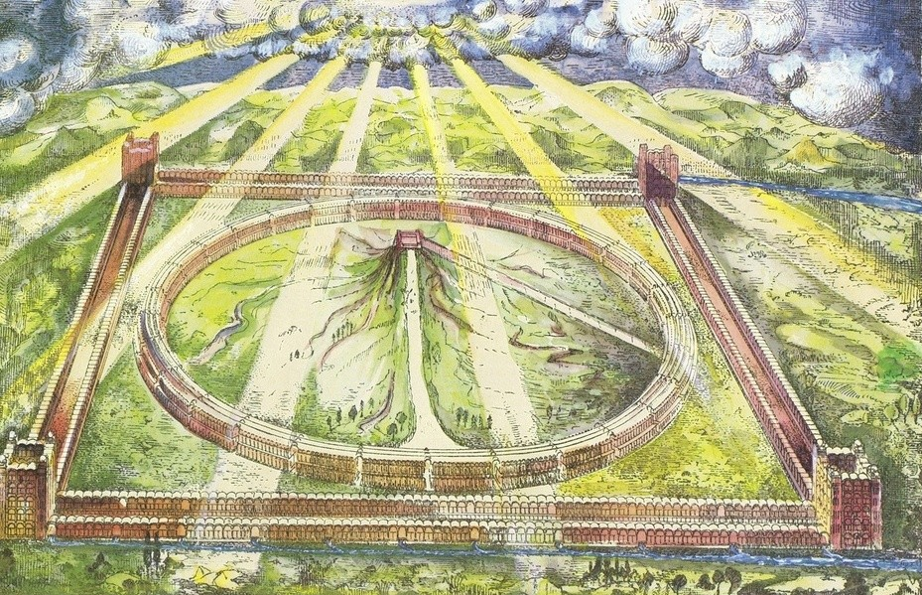
The Millennial Reign of Christ

Slide 2
The term MILLENNIUM is comprised of two Latin words, meaning a thousand years:
mille = a thousand
annus = a year
“a thousand years”

Slide 3
Unamended Statement of Faith Propositions
XXVII.
That the kingdom of God, thus constituted, will continue a thousand years, during which sin and death will continue among the earth’s subject- inhabitants, though in a much milder degree than now. (Isa. 65:20; Ezek. 44:22, 25; 1st Cor. 15:24, 29; Rev. 20:7-9).
XXVIII.
That the mission of the kingdom will be to subdue all enemies, and finally death itself by opening up the way of life to the nations, which they will enter by faith, during the thousand years, and (in reality) at their close. (Isa. 25:6-8; 1st Cor. 15:24-26; Rev. 20:12-15; 21:4).

Slide 4
XXIX.
That at the close of the thousand years, there will be a general resurrection and judgment, resulting in the final extinction of the wicked, and the immortalization of those who shall have established their title (under the grace of God) to eternal life during the thousand years. (1st Cor. 15:24; Rev. 20:11-15).
XXX.
That the government (in its mediatorial aspect) will then be delivered up by Jesus to the Father, who will manifest Himself as the “All-in-all;” sin and death having been taken out of the way, and the obedient of the race completely restored to the friendship of the Deity. (1st Cor. 15:28).

Slide 5
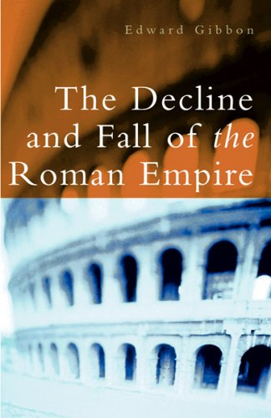
“The ancient and popular doctrine of the Millennium was intimately connected to the second coming of Christ…a joyful sabbath of a 1000 years when Christ, with the triumphant hand of the saints, and the elect who had escaped death, or who had been miraculously revived, would reign upon earth…The assurance of such a Millennium was carefully inculcated by succession of fathers from Justin Martyr and Irenaeus who conversed with the immediate disciples of the apostles, down to Lactantius, who was preceptor to the son of Constantine…But when the edifice of the church was almost completed, the temporary support was laid aside. The doctrine of Christ’s reign upon earth was at first treated as a profound allegory, was considered by degrees as a doubtful and useless opinion, and was at length rejected as the absurd invention of heresy and fanaticism.”
Gibbon, The Decline and Fall of the Roman Empire

Slide 6
Psalm 72
“1 Give the king thy judgments, O God, and thy righteousness unto the king's son. 2 He shall judge thy people with righteousness, and thy poor with judgment. 3 The mountains shall bring peace to the people, and the little hills, by righteousness. 4 He shall judge the poor of the people, he shall save the children of the needy, and shall break in pieces the oppressor. 5 They shall fear thee as long as the sun and moon endure, throughout all generations. 6 He shall come down like rain upon the mown grass: as showers that water the earth. 7 In his days shall the righteous flourish; and abundance of peace so long as the moon endureth. 8 He shall have dominion also from sea to sea, and from the river unto the ends of the earth. 9 They that dwell in the wilderness shall bow before him; and his enemies shall lick the dust. 10 The kings of Tarshish and of the isles shall bring presents: the kings of Sheba and Seba shall offer gifts. 11 Yea, all kings shall fall down before him: all nations shall serve him. 12 For he shall deliver the needy when he crieth; the poor also, and him that hath no helper.

Slide 7
Psalm 72 (cont.)
13 He shall spare the poor and needy, and shall save the souls of the needy. 14 He shall redeem their soul from deceit and violence: and precious shall their blood be in his sight. 15 And he shall live , and to him shall be given of the gold of Sheba: prayer also shall be made for him continually; and daily shall he be praised. 16 There shall be an handful of corn in the earth upon the top of the mountains; the fruit thereof shall shake like Lebanon: and they of the city shall flourish like grass of the earth. 17 His name shall endure for ever: his name shall be continued as long as the sun: and men shall be blessed in him: all nations shall call him blessed. 18 Blessed be the LORD God, the God of Israel, who only doeth wondrous things. 19 And blessed be his glorious name for ever: and let the whole earth be filled with his glory; Amen, and Amen. 20 The prayers of David the son of Jesse are ended.”

Slide 8
The Millennial Reign of Christ

