Slide 1
The Old Path
CLASS SIX .............PATH
DESTINY

Slide 2
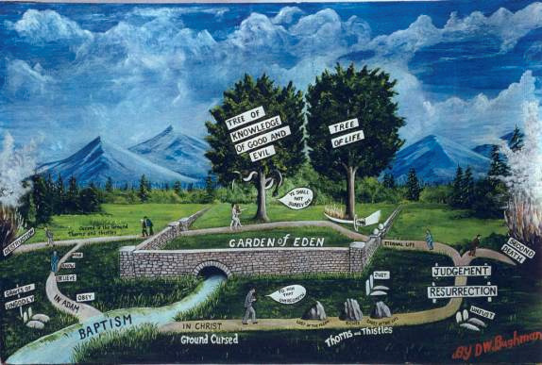
PATH DESTINY

Slide 3
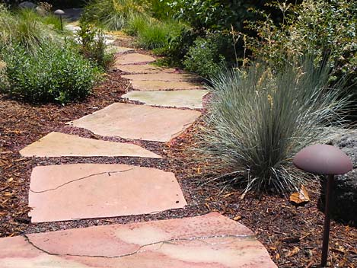
HOBBIES
JOBS
SICKNESS
DESIRES
CARES OF
THIS LIFE
COVETOUSNESS
RICHES
LUST OF THE FLESH

Slide 4
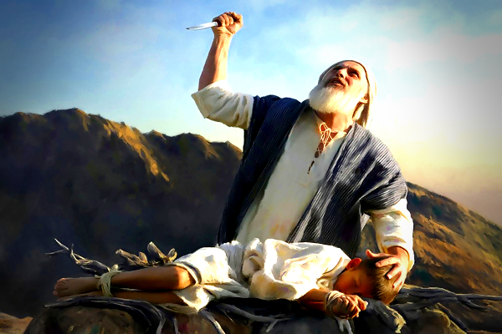
Gen 22:1 And it came to pass after these things, that God did tempt Abraham, and said unto him, Abraham: and he said, Behold, here I am.
Gen 22:2 And he said, Take now thy son, thine only son Isaac, whom thou lovest, and get thee into the land of Moriah; and offer him there for a burnt offering upon one of the mountains which I will tell thee of.

Slide 5
Jas 1:13 Let no man say when he is tempted, I am tempted of God: for God cannot be tempted with evil, neither tempteth he any man:

Slide 6
H5254 nâsâh naw-saw'
A primitive root; to test; by implication to attempt: - adventure, assay, prove, tempt, try.
The greek Hebrew study bible runs it as ............
To test, try, or prove. To put to the proof.

Slide 7
2Ch 32:31 Howbeit in the business of the ambassadors of the princes of Babylon, who sent unto him to enquire of the wonder that was done in the land, God left him, to try him, that he might know all that was in his heart.

Slide 8
Exo 16:4 Then said the LORD unto Moses, Behold, I will rain bread from heaven for you; and the people shall go out and gather a certain rate every day, that I may prove them, whether they will walk in my law, or no.
Deu 8:2 And thou shalt remember all the way which the LORD thy God led thee these forty years in the wilderness, to humble thee, and to prove thee, to know what was in thine heart, whether thou wouldest keep his commandments, or no.
Jdg 2:22 That through them I may prove Israel, whether they will keep the way of the LORD to walk therein, as their fathers did keep it, or not.
PROVE = H5254 nâsâh naw-saw'

Slide 9
Exo 15:23 And when they came to Marah, they could not drink of the waters of Marah, for they were bitter: therefore the name of it was called Marah.
Exo 15:24 And the people murmured against Moses, saying, What shall we drink?
Exo 15:25 And he cried unto the LORD; and the LORD shewed him a tree, which when he had cast into the waters, the waters were made sweet: there he made for them a statute and an ordinance, and there he proved them,

Slide 10
Psa 26:1 A Psalm of David. Judge me, O LORD; for I have walked in mine integrity: I have trusted also in the LORD; therefore I shall not slide.
Psa 26:2 Examine me, O LORD, and prove me; try my reins and my heart.
Psa 26:3 For thy lovingkindness is before mine eyes: and I have walked in thy truth.

Slide 11
TRY........H6884 tsâraph tsaw-raf'
A primitive root; to fuse (metal), that is, refine (literally or figuratively): - cast, (re-) fine (-er), founder, goldsmith, melt, pure, purge away, try.

Slide 12
Heb 12:5 And ye have forgotten the exhortation which speaketh unto you as unto children, My son, despise not thou the chastening of the Lord, nor faint when thou art rebuked of him:
Heb 12:6 For whom the Lord loveth he chasteneth, and scourgeth every son whom he receiveth.
Heb 12:7 If ye endure chastening, God dealeth with you as with sons; for what son is he whom the father chasteneth not?

Slide 13
Chastening = G3809 Paideia pahee-di'-ah
From G3811; tutorage, that is, education or training; by implication disciplinary correction: - chastening, chastisement, instruction, nurture.

Slide 14
Act_14:22 Confirming the souls of the disciples, and exhorting them to continue in the faith, and that we must through much tribulation enter into the kingdom of God.

Slide 15
Jas 1:2 My brethren, count it all joy when ye fall into divers temptations;
Jas 1:3 Knowing this, that the trying of your faith worketh patience.

Slide 16
Mat 5:11 Blessed are ye, when men shall revile you, and persecute you, and shall say all manner of evil against you falsely, for my sake.
Mat 5:12 Rejoice, and be exceeding glad: for great is your reward in heaven: for so persecuted they the prophets which were before you.

Slide 17
Jas 1:12 Blessed is the man that endureth temptation: for when he is tried, he shall receive the crown of life, which the Lord hath promised to them that love him.

Slide 18
Jas 1:15 Then when lust hath conceived, it bringeth forth sin: and sin, when it is finished, bringeth forth death.
Jas 1:16 Do not err, my beloved brethren.

Slide 19
1Pe 1:7 That the trial of your faith, being much more precious than of gold that perisheth, though it be tried with fire, might be found unto praise and honour and glory at the appearing of Jesus Christ:

Slide 20
Psa 37:1 A Psalm of David. Fret not thyself because of evildoers, neither be thou envious against the workers of iniquity.
Psa 37:2 For they shall soon be cut down like the grass, and wither as the green herb.
Psa 37:3 Trust in the LORD, and do good; so shalt thou dwell in the land, and verily thou shalt be fed.
Psa 37:4 Delight thyself also in the LORD; and he shall give thee the desires of thine heart.
Psa 37:5 Commit thy way unto the LORD; trust also in him; and he shall bring it to pass.
Psa 37:6 And he shall bring forth thy righteousness as the light, and thy judgment as the noonday.
Psa 37:7 Rest in the LORD, and wait patiently for him: fret not thyself because of him who prospereth in his way, because of the man who bringeth wicked devices to pass.
Psa 37:8 Cease from anger, and forsake wrath: fret not thyself in any wise to do evil.
Psa 37:9 For evildoers shall be cut off: but those that wait upon the LORD, they shall inherit the earth.
Psa 37:10 For yet a little while, and the wicked shall not be: yea, thou shalt diligently consider his place, and it shall not be.
Psa 37:11 But the meek shall inherit the earth; and shall delight themselves in the abundance of peace.

Slide 21
TRUST
DELIGHT
COMMIT
REST

Slide 22
Isa 26:2 Open ye the gates, that the righteous nation which keepeth the truth may enter in.
Isa 26:3 Thou wilt keep him in perfect peace, whose mind is stayed on thee: because he trusteth in thee.
Isa 26:4 Trust ye in the LORD for ever: for in the LORD JEHOVAH is everlasting strength:
Isa 26:5 For he bringeth down them that dwell on high; the lofty city, he layeth it low; he layeth it low, even to the ground; he bringeth it even to the dust.
Isa 26:6 The foot shall tread it down, even the feet of the poor, and the steps of the needy.
Isa 26:7 The way of the just is uprightness: thou, most upright, dost weigh the path of the just.

Slide 23
1Ti 1:1 Paul, an apostle of Jesus Christ by the commandment of God our Saviour, and Lord Jesus Christ, which is our hope;
1Ti 1:2 Unto Timothy, my own son in the faith: Grace, mercy, and peace, from God our Father and Jesus Christ our Lord.

Slide 24
Rom 5:1 Therefore being justified by faith, we have peace with God through our Lord Jesus Christ:
Rom 5:2 By whom also we have access by faith into this grace wherein we stand, and rejoice in hope of the glory of God.
Rom 5:3 And not only so, but we glory in tribulations also: knowing that tribulation worketh patience;
Rom 5:4 And patience, experience; and experience, hope:

Slide 25
Joh 14:27 Peace I leave with you, my peace I give unto you: not as the world giveth, give I unto you. Let not your heart be troubled, neither let it be afraid.

Slide 26
Php 4:6 Be careful for nothing; but in every thing by prayer and supplication with thanksgiving let your requests be made known unto God.
Php 4:7 And the peace of God, which passeth all understanding, shall keep your hearts and minds through Christ Jesus.

Slide 27
1Co 14:33 For God is not the author of confusion, but of peace, as in all ecclesia’s of the saints.

Slide 28
Psa 5:4 For thou art not a God that hath pleasure in wickedness: neither shall evil dwell with thee.
Psa 5:5 The foolish shall not stand in thy sight: thou hatest all workers of iniquity.
Psa 5:6 Thou shalt destroy them that speak leasing: the LORD will abhor the bloody and deceitful man.

Slide 29
2Pe 3:9 The Lord is not slack concerning his promise, as some men count slackness; but is longsuffering to us-ward, not willing that any should perish, but that all should come to repentance.

Slide 30
Rom 2:3 And thinkest thou this, O man, that judgest them which do such things, and doest the same, that thou shalt escape the judgment of God?
Rom 2:4 Or despisest thou the riches of his goodness and forbearance and longsuffering; not knowing that the goodness of God leadeth thee to repentance?
Rom 2:5 But after thy hardness and impenitent heart treasurest up unto thyself wrath against the day of wrath and revelation of the righteous judgment of God;
Rom 2:6 Who will render to every man according to his deeds:
Rom 2:7 To them who by patient continuance in well doing seek for glory and honour and immortality, eternal life:
Rom 2:8 But unto them that are contentious, and do not obey the truth, but obey unrighteousness, indignation and wrath,
Rom 2:9 Tribulation and anguish, upon every soul of man that doeth evil, of the Jew first, and also of the Gentile;
Rom 2:10 But glory, honour, and peace, to every man that worketh good, to the Jew first, and also to the Gentile:
Rom 2:11 For there is no respect of persons with God.

Slide 31
Psa 37:10 For yet a little while, and the wicked shall not be: yea, thou shalt diligently consider his place, and it shall not be.
Psa 37:11 But the meek shall inherit the earth; and shall delight themselves in the abundance of peace.

Slide 32
Psa 37:37 Mark the perfect man, and behold the upright: for the end of that man is peace.

Slide 33
Isa 48:22 There is no peace, saith the LORD, unto the wicked.

Slide 34
Rom 3:13 Their throat is an open sepulchre; with their tongues they have used deceit; the poison of asps is under their lips:
Rom 3:14 Whose mouth is full of cursing and bitterness:
Rom 3:15 Their feet are swift to shed blood:
Rom 3:16 Destruction and misery are in their ways:
Rom 3:17 And the way of peace have they not known:

Slide 35
Isa 57:17 For the iniquity of his covetousness was I wroth, and smote him: I hid me, and was wroth, and he went on frowardly in the way of his heart.
Isa 57:18 I have seen his ways, and will heal him: I will lead him also, and restore comforts unto him and to his mourners.
Isa 57:19 I create the fruit of the lips; Peace, peace to him that is far off, and to him that is near, saith the LORD; and I will heal him.
Isa 57:20 But the wicked are like the troubled sea, when it cannot rest, whose waters cast up mire and dirt.
Isa 57:21 There is no peace, saith my God, to the wicked.

Slide 36
1Co 2:9 But as it is written, Eye hath not seen, nor ear heard, neither have entered into the heart of man, the things which God hath prepared for them that love him.

Slide 37
Joh 16:33 These things I have spoken unto you, that in me ye might have peace. In the world ye shall have tribulation: but be of good cheer; I have overcome the world.

Slide 38
1Jn 1:8 If we say that we have no sin, we deceive ourselves, and the truth is not in us.
1Jn 1:9 If we confess our sins, he is faithful and just to forgive us our sins, and to cleanse us from all unrighteousness.

Slide 39
Mat 6:25 Therefore I say unto you, Take no thought for your life, what ye shall eat, or what ye shall drink; nor yet for your body, what ye shall put on. Is not the life more than meat, and the body than raiment?
Mat 6:26 Behold the fowls of the air: for they sow not, neither do they reap, nor gather into barns; yet your heavenly Father feedeth them. Are ye not much better than they?
Mat 6:27 Which of you by taking thought can add one cubit unto his stature?
Mat 6:28 And why take ye thought for raiment? Consider the lilies of the field, how they grow; they toil not, neither do they spin:
Mat 6:29 And yet I say unto you, That even Solomon in all his glory was not arrayed like one of these.
Mat 6:30 Wherefore, if God so clothe the grass of the field, which to day is, and to morrow is cast into the oven, shall he not much more clothe you, O ye of little faith?
Mat 6:31 Therefore take no thought, saying, What shall we eat? or, What shall we drink? or, Wherewithal shall we be clothed?
Mat 6:32 (For after all these things do the Gentiles seek:) for your heavenly Father knoweth that ye have need of all these things.
Mat 6:33 But seek ye first the kingdom of God, and his righteousness; and all these things shall be added unto you.
Mat 6:34 Take therefore no thought for the morrow: for the morrow shall take thought for the things of itself. Sufficient unto the day is the evil thereof.

Slide 40
Rom 5:1 Therefore being justified by faith, we have peace with God through our Lord Jesus Christ:
Rom 5:2 By whom also we have access by faith into this grace wherein we stand, and rejoice in hope of the glory of God.
Rom 5:3 And not only so, but we glory in tribulations also: knowing that tribulation worketh patience;
Rom 5:4 And patience, experience; and experience, hope:
Rom 5:5 And hope maketh not ashamed; because the love of God is shed abroad in our hearts by the Holy Ghost which is given unto us.

Slide 41
Psa 119:165 Great peace have they which love thy law: and nothing shall offend them.

Slide 42
Col 1:19 For it pleased the Father that in him should all fulness dwell;
Col 1:20 And, having made peace through the blood of his cross, by him to reconcile all things unto himself; by him, I say, whether they be things in earth, or things in heaven.
Col 1:21 And you, that were sometime alienated and enemies in your mind by wicked works, yet now hath he reconciled
Col 1:22 In the body of his flesh through death, to present you holy and unblameable and unreproveable in his sight:

Slide 43
Php 4:6 Be careful for nothing; but in every thing by prayer and supplication with thanksgiving let your requests be made known unto God.
Php 4:7 And the peace of God, which passeth all understanding, shall keep your hearts and minds through Christ Jesus.

Slide 44
Jas 5:16 Confess your faults one to another, and pray one for another, that ye may be healed. The effectual fervent prayer of a righteous man availeth much.

Slide 45
Isa 26:3 Thou wilt keep him in perfect peace, whose mind is stayed on thee: because he trusteth in thee.
Isa 26:4 Trust ye in the LORD for ever: for in the LORD JEHOVAH is everlasting strength:

Slide 46
STAYED = H5564 sâmak saw-mak'
A primitive root; to prop (literally or figuratively); reflexively to lean upon or take hold of (in a favorable or unfavorable sense): - bear up, establish, (up-) hold, lay, lean, lie hard, put, rest self, set self, stand fast, stay (self), sustain.

Slide 47
Pro 1:33 But whoso hearkeneth unto me shall dwell safely, and shall be quiet from fear of evil.
Psa 23:4 Yea, though I walk through the valley of the shadow of death, I will fear no evil: for thou art with me; thy rod and thy staff they comfort me.

Slide 48
Psa 4:4 Stand in awe, and sin not: commune with your own heart upon your bed, and be still. Selah.
Psa 4:5 Offer the sacrifices of righteousness, and put your trust in the LORD.
Psa 4:6 There be many that say, Who will shew us any good? LORD, lift thou up the light of thy countenance upon us.
Psa 4:7 Thou hast put gladness in my heart, more than in the time that their corn and their wine increased.
Psa 4:8 I will both lay me down in peace, and sleep: for thou, LORD, only makest me dwell in safety.
Psa 4:4 Stand in awe, and sin not: commune with your own heart upon your bed, and be still. Selah.

Slide 49
Jas 3:14 But if ye have bitter envying and strife in your hearts, glory not, and lie not against the truth.
Jas 3:15 This wisdom descendeth not from above, but is earthly, sensual, devilish.
Jas 3:16 For where envying and strife is, there is confusion and every evil work.
Jas 3:17 But the wisdom that is from above is first pure, then peaceable, gentle, and easy to be intreated, full of mercy and good fruits, without partiality, and without hypocrisy.
Jas 3:18 And the fruit of righteousness is sown in peace of them that make peace.

Slide 50
Tit 3:3 For we ourselves also were sometimes foolish, disobedient, deceived, serving divers lusts and pleasures, living in malice and envy, hateful, and hating one another.

Slide 51
1Co 15:49 And as we have borne the image of the earthy, we shall also bear the image of the heavenly.
1Co 15:50 Now this I say, brethren, that flesh and blood cannot inherit the kingdom of God; neither doth corruption inherit incorruption.
1Co 15:51 Behold, I shew you a mystery; We shall not all sleep, but we shall all be changed,
1Co 15:52 In a moment, in the twinkling of an eye, at the last trump: for the trumpet shall sound, and the dead shall be raised incorruptible, and we shall be changed.
1Co 15:53 For this corruptible must put on incorruption, and this mortal must put on immortality.
1Co 15:54 So when this corruptible shall have put on incorruption, and this mortal shall have put on immortality, then shall be brought to pass the saying that is written, Death is swallowed up in victory.
1Co 15:55 O death, where is thy sting? O grave, where is thy victory?
1Co 15:56 The sting of death is sin; and the strength of sin is the law.
1Co 15:57 But thanks be to God, which giveth us the victory through our Lord Jesus Christ.
1Co 15:58 Therefore, my beloved brethren, be ye stedfast, unmoveable, always abounding in the work of the Lord, forasmuch as ye know that your labour is not in vain in the Lord.

Slide 52
FULL CIRCLE TO LIFE ETERNAL

