Slide 1
The Old Path
CLASS ONE .............THE PATH OF RIGHTEOUSNESS

Slide 2
ARKANSAS BIBLE SCHOOL 2015
Jas 5:8 Be ye also patient; stablish your hearts: for the coming of the Lord draweth nigh.

Slide 3
stablish G4741 stērizō stay-rid'-zo
From a presumed derivative of G2476 (like G4731); to set fast, that is, (literally) to turn resolutely in a certain direction, or (figuratively) to confirm: - fix, (e-) stablish, stedfastly set, strengthen.
And heart is from G2588
καρδία
kardia
kar-dee'-ah
Prolonged from a primary κάρ kar (Latin cor, “heart”); the heart, that is, (figuratively) the thoughts or feelings (mind); also (by analogy) the middle: - (+ broken-) heart (-ed).

Slide 4
Luk 18:8 I tell you that he will avenge them speedily. Nevertheless when the Son of man cometh, shall he find faith on the earth?

Slide 5
Rev 3:1 And unto the angel of the church in Sardis write; These things saith he that hath the seven Spirits of God, and the seven stars; I know thy works, that thou hast a name that thou livest, and art dead.
Rev 3:2 Be watchful, and strengthen the things which remain, that are ready to die: for I have not found thy works perfect before God.
Rev 3:3 Remember therefore how thou hast received and heard, and hold fast, and repent. If therefore thou shalt not watch, I will come on thee as a thief, and thou shalt not know what hour I will come upon thee.

Slide 6
Jer 6:16 Thus saith the LORD, Stand ye in the ways, and see, and ask for the old paths, where is the good way, and walk therein, and ye shall find rest for your souls. But they said, We will not walk therein.

Slide 7
2Ti_2:15 Study to shew thyself approved unto God, a workman that needeth not to be ashamed, rightly dividing the word of truth.

Slide 8
With earnest speed.........diligently stand beside and exhibit ourselves to be properly acceptable unto God.......a toiler/laborer/teacher.....that is blameless, faultless, spotless.......cutting and dissecting correctly the logos of Alethia or “word of truth”...............

Slide 9
But they said, We will not walk therein

Slide 10
Act 1:6 When they therefore were come together, they asked of him, saying, Lord, wilt thou at this time restore again the kingdom to Israel?
Act 1:7 And he said unto them, It is not for you to know the times or the seasons, which the Father hath put in his own power.
Act 1:8 But ye shall receive power, after that the Holy Ghost is come upon you: and ye shall be witnesses unto me both in Jerusalem, and in all Judaea, and in Samaria, and unto the uttermost part of the earth.
Act 1:9 And when he had spoken these things, while they beheld, he was taken up; and a cloud received him out of their sight.

Slide 11
Mat 10:6 But go rather to the lost sheep of the house of Israel.
Mat 10:7 And as ye go, preach, saying, The kingdom of heaven is at hand.

Slide 12
Stand ye in the ways, and see
ask for the old paths,
where is the good way
walk therein
and ye shall find rest for your souls

Slide 13
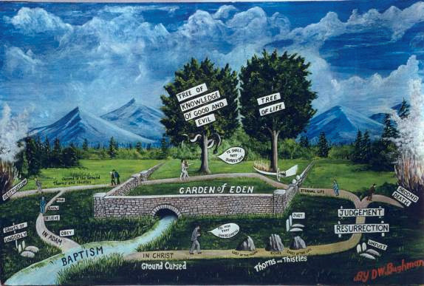
STAND IN THE WAYS

Slide 14
Transgress...............H5674 âbar aw-bar'
A primitive root; to cross over; - alienate, alter, fail, turn away,

Slide 15
Gen 3:14 And the LORD God said unto the serpent, Because thou hast done this, thou art cursed above all cattle, and above every beast of the field; upon thy belly shalt thou go, and dust shalt thou eat all the days of thy life:
Gen 3:15 And I will put enmity between thee and the woman, and between thy seed and her seed; it shall bruise thy head, and thou shalt bruise his heel.

Slide 16
Gen 3:16 Unto the woman he said, I will greatly multiply thy sorrow and thy conception; in sorrow thou shalt bring forth children; and thy desire shall be to thy husband, and he shall rule over thee.
1Ti 2:13 For Adam was first formed, then Eve.
1Ti 2:14 And Adam was not deceived, but the woman being deceived was in the transgression.

Slide 17
Gen 3:17 And unto Adam he said, Because thou hast hearkened unto the voice of thy wife, and hast eaten of the tree, of which I commanded thee, saying, Thou shalt not eat of it: cursed is the ground for thy sake; in sorrow shalt thou eat of it all the days of thy life;
Gen 3:18 Thorns also and thistles shall it bring forth to thee; and thou shalt eat the herb of the field;
Gen 3:19 In the sweat of thy face shalt thou eat bread, till thou return unto the ground; for out of it wast thou taken: for dust thou art, and unto dust shalt thou return.

Slide 18
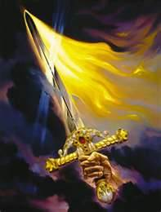
Gen 3:24 So he drove out the man; and he placed at the east of the garden of Eden Cherubims, and a flaming sword which turned every way, to keep the way of the tree of life.

Slide 19
Rom 5:12 Wherefore, as by one man sin entered into the world, and death by sin; and so death passed upon all men, for that all have sinned:

Slide 20
1Jn 2:16 For all that is in the world, the lust of the flesh, and the lust of the eyes, and the pride of life, is not of the Father, but is of the world.

Slide 22
Landmark H1366 g^{e}bûl gebûl gheb-ool', gheb-ool'
From H1379; properly a cord (as twisted), that is, (by implication) a boundary; by extension the territory inclosed: - border, bound, coast, X great, landmark, limit, quarter, space.

Slide 24
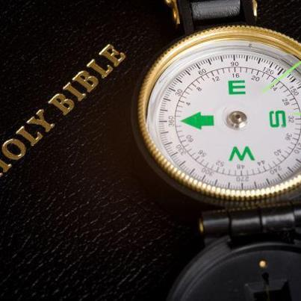

Slide 25
1Co 2:9 But as it is written, Eye hath not seen, nor ear heard, neither have entered into the heart of man, the things which God hath prepared for them that love him.
1Co 2:10 But God hath revealed them unto us by his Spirit: for the Spirit searcheth all things, yea, the deep things of God.
1Co 2:11 For what man knoweth the things of a man, save the spirit of man which is in him? even so the things of God knoweth no man, but the Spirit of God.
1Co 2:12 Now we have received, not the spirit of the world, but the spirit which is of God; that we might know the things that are freely given to us of God.

Slide 26
WORLD
GOD
PRIMARY......SECONDARY

Slide 27
Pro 4:10 Hear, O my son, and receive my sayings; and the years of thy life shall be many.
Pro 4:11 I have taught thee in the way of wisdom; I have led thee in right paths.
Pro 4:12 When thou goest, thy steps shall not be straitened; and when thou runnest, thou shalt not stumble.
Pro 4:13 Take fast hold of instruction; let her not go: keep her; for she is thy life.
Pro 4:14 Enter not into the path of the wicked, and go not in the way of evil men.
Pro 4:15 Avoid it, pass not by it, turn from it, and pass away.
Pro 4:16 For they sleep not, except they have done mischief; and their sleep is taken away, unless they cause some to fall.
Pro 4:17 For they eat the bread of wickedness, and drink the wine of violence.
Pro 4:18 But the path of the just is as the shining light, that shineth more and more unto the perfect day.
Pro 4:19 The way of the wicked is as darkness: they know not at what they stumble.
Pro 4:20 My son, attend to my words; incline thine ear unto my sayings.
Pro 4:21 Let them not depart from thine eyes; keep them in the midst of thine heart.
Pro 4:22 For they are life unto those that find them, and health to all their flesh.
Pro 4:23 Keep thy heart with all diligence; for out of it are the issues of life.
Pro 4:24 Put away from thee a froward mouth, and perverse lips put far from thee.
Pro 4:25 Let thine eyes look right on, and let thine eyelids look straight before thee.
Pro 4:26 Ponder the path of thy feet, and let all thy ways be established.
Pro 4:27 Turn not to the right hand nor to the left: remove thy foot from evil.

Slide 28
Pro 4:18 But the path of the just is as the shining light, that shineth more and more unto the perfect day.
Pro 4:19 The way of the wicked is as darkness: they know not at what they stumble.

Slide 29
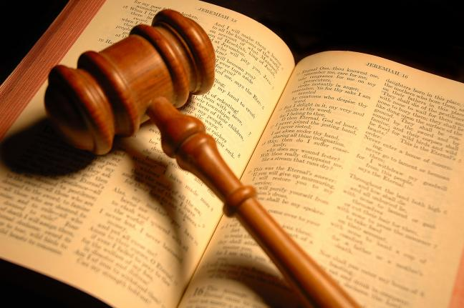
THE “SUPREMEST” COURT

Slide 30
Deu 6:1 Now these are the commandments, the statutes, and the judgments, which the LORD your God commanded to teach you, that ye might do them in the land whither ye go to possess it:
Deu 6:2 That thou mightest fear the LORD thy God, to keep all his statutes and his commandments, which I command thee, thou, and thy son, and thy son's son, all the days of thy life; and that thy days may be prolonged.
Deu 6:3 Hear therefore, O Israel, and observe to do it; that it may be well with thee, and that ye may increase mightily, as the LORD God of thy fathers hath promised thee, in the land that floweth with milk and honey.
Deu 6:4 Hear, O Israel: The LORD our God is one LORD:
Deu 6:5 And thou shalt love the LORD thy God with all thine heart, and with all thy soul, and with all thy might.
Deu 6:6 And these words, which I command thee this day, shall be in thine heart:
Deu 6:7 And thou shalt teach them diligently unto thy children, and shalt talk of them when thou sittest in thine house, and when thou walkest by the way, and when thou liest down, and when thou risest up.
Deu 6:8 And thou shalt bind them for a sign upon thine hand, and they shall be as frontlets between thine eyes.
Deu 6:9 And thou shalt write them upon the posts of thy house, and on thy gates.

Slide 31
Deu 28:1 And it shall come to pass, if thou shalt hearken diligently unto the voice of the LORD thy God, to observe and to do all his commandments which I command thee this day, that the LORD thy God will set thee on high above all nations of the earth:
Deu 28:2 And all these blessings shall come on thee, and overtake thee, if thou shalt hearken unto the voice of the LORD thy God.

Slide 32
Hearken...............H8085 shâma‛ shaw-mah'
A primitive root; to hear intelligently (often with implication of attention, obedience, etc.; causatively to tell, etc.): - X attentively, call (gather) together, X carefully, X certainly, consent, consider, be content, declare, X diligently, discern, give ear, (cause to, let, make to) hear (-ken, tell), X indeed, listen, make (a) noise, (be) obedient, obey, perceive, (make a) proclaim (-ation), publish, regard, report, shew (forth), (make a) sound, X surely, tell, understand, whosoever [heareth], witness.

Slide 33
Pro 4:20 My son, attend to my words; incline thine ear unto my sayings.
Pro 4:21 Let them not depart from thine eyes; keep them in the midst of thine heart.
Pro 4:22 For they are life unto those that find them, and health to all their flesh.
Pro 4:23 Keep thy heart with all diligence; for out of it are the issues of life.

Slide 34
Deu 28:14 And thou shalt not go aside from any of the words which I command thee this day, to the right hand, or to the left, to go after other gods to serve them.

Slide 35
Deu 28:15 But it shall come to pass, if thou wilt not hearken unto the voice of the LORD thy God, to observe to do all his commandments and his statutes which I command thee this day; that all these curses shall come upon thee, and overtake thee:

Slide 36
Pro 4:25 Let thine eyes look right on, and let thine eyelids look straight before thee.
Pro 4:26 Ponder the path of thy feet, and let all thy ways be established.
Pro 4:27 Turn not to the right hand nor to the left: remove thy foot from evil.

Slide 37
Pro_3:6 In all thy ways acknowledge him, and he shall direct thy paths.

Slide 38
Jer_10:23 O LORD, I know that the way of man is not in himself: it is not in man that walketh to direct his steps.

Slide 39
Mat 7:13 Enter ye in at the strait gate: for wide is the gate, and broad is the way, that leadeth to destruction, and many there be which go in thereat:
Mat 7:14 Because strait is the gate, and narrow is the way, which leadeth unto life, and few there be that find it.

Slide 40
2Pe 1:4 Whereby are given unto us exceeding great and precious promises: that by these ye might be partakers of the divine nature, having escaped the corruption that is in the world through lust.

Slide 41
What makes a promise precious? 1. The thing promised must be valuable. 2. He who promises must be truthful. 3. He who promises must be able to perform.

Slide 42
Joh_14:6 Jesus saith unto him, I am the way, the truth, and the life: no man cometh unto the Father, but by me.

Slide 43
where is the good way, and walk therein;

Slide 44
Joh 14:6 Jesus saith unto him, I am the way, the truth, and the life: no man cometh unto the Father, but by me.
Joh 14:7 If ye had known me, ye should have known my Father also: and from henceforth ye know him, and have seen him.

Slide 45
Joh 10:29 My Father, which gave them me, is greater than all; and no man is able to pluck them out of my Father's hand.
Joh 10:30 I and my Father are one.
Joh 10:31 Then the Jews took up stones again to stone him.
Joh 10:32 Jesus answered them, Many good works have I shewed you from my Father; for which of those works do ye stone me?
Joh 10:33 The Jews answered him, saying, For a good work we stone thee not; but for blasphemy; and because that thou, being a man, makest thyself God.

